Slide 1
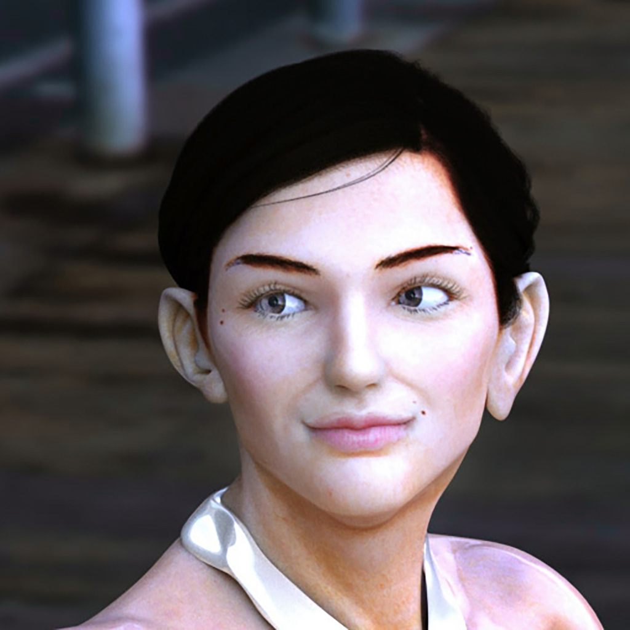
“Project 1: Miranda ——The Art of Anatomy & Expression——”
Koji Sato（a.k.a. Renpoo Tsukioka）
Started my career as 3D computer graphics designer
2025/06/12

Slide 2
A Long-time Dedication to 3DCG as an Independent Artist
Experience being selected for screenings at an international conference (SIGGRAPH ’97 Electronic Theater).
Created CG for major animations, video games and automobile companies.
Specializing in animating 3DCG with an illustrative, non-photorealistic style.
Pioneered muscle expression and simulation techniques in 3DCG when few precedents existed.

Slide 3
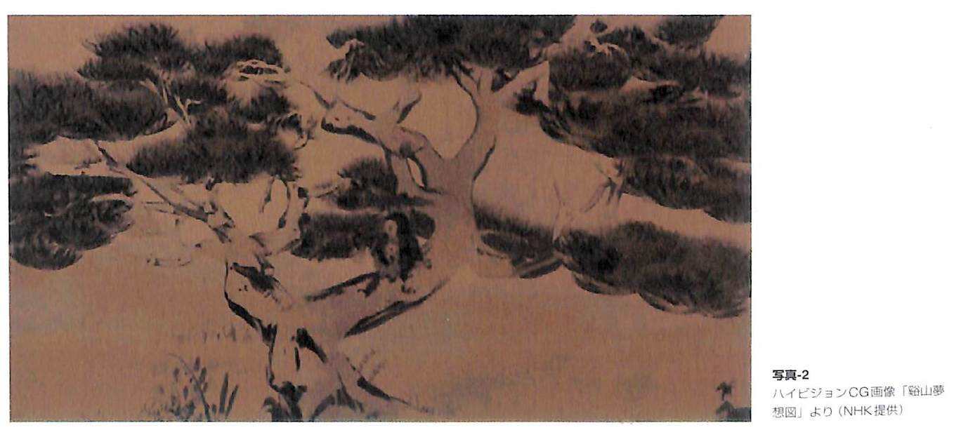
"KEIZAN MUSOUZU" —Selected for the screening at an international conference (ACM SIGGRAPH ’97) —

Slide 4
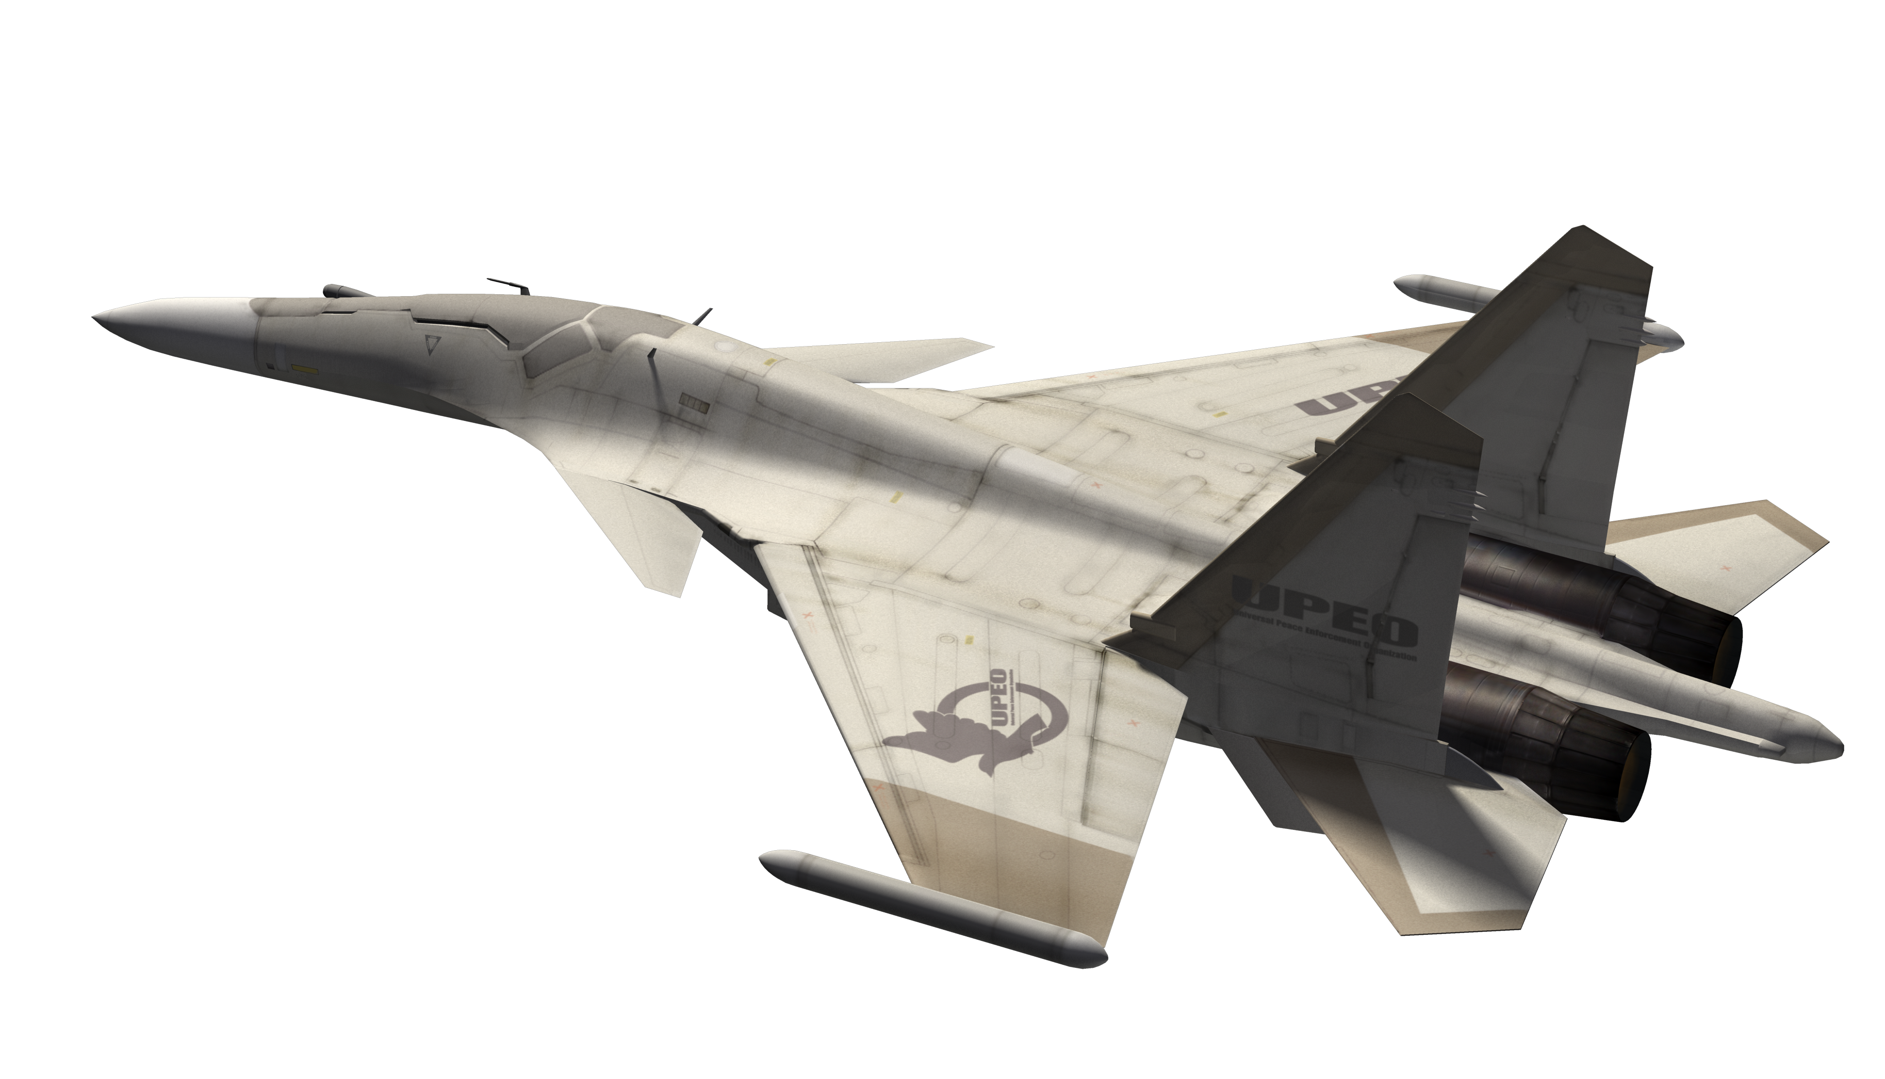
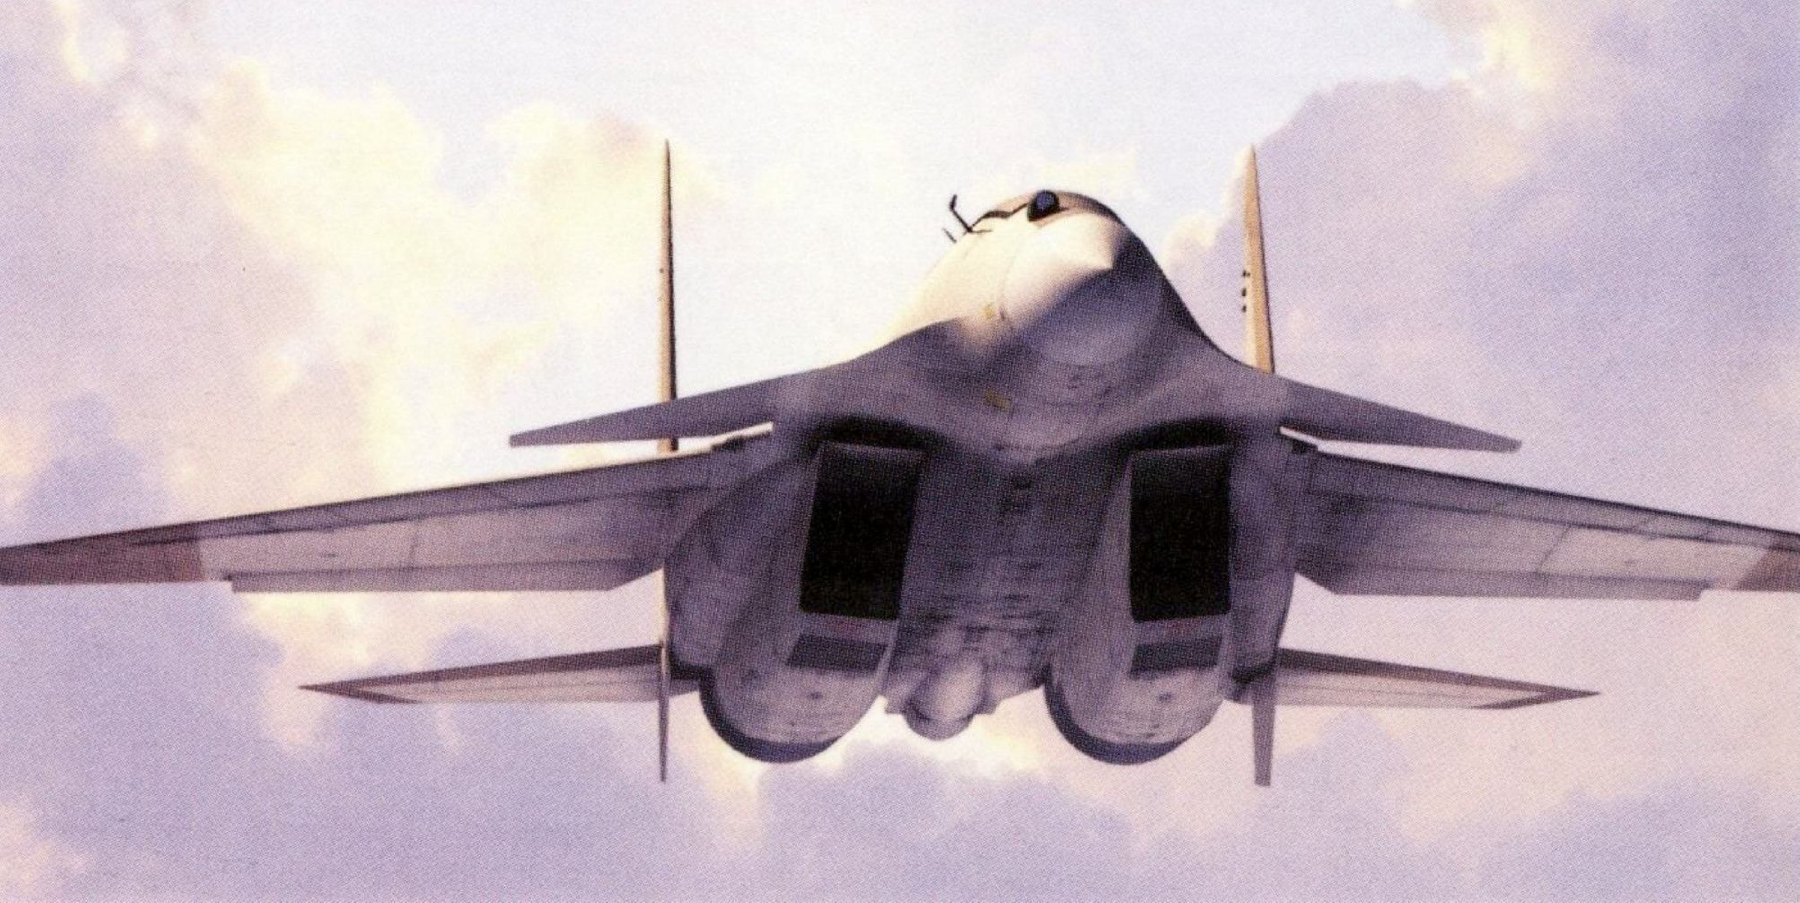
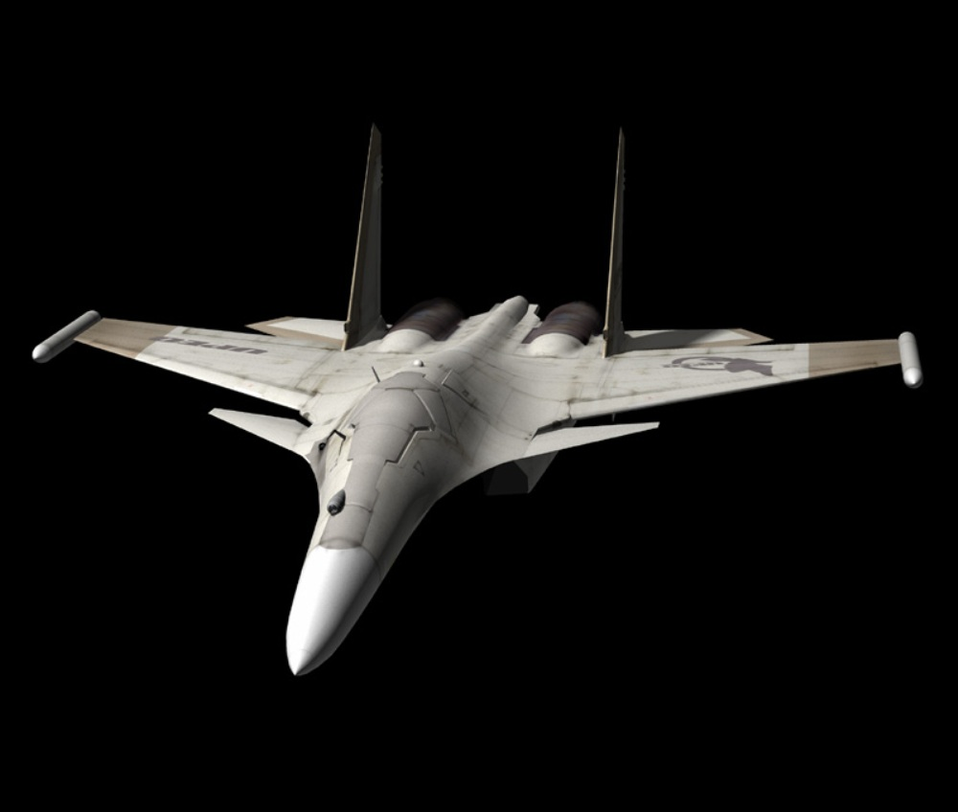
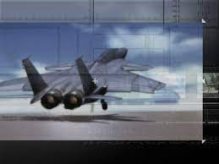
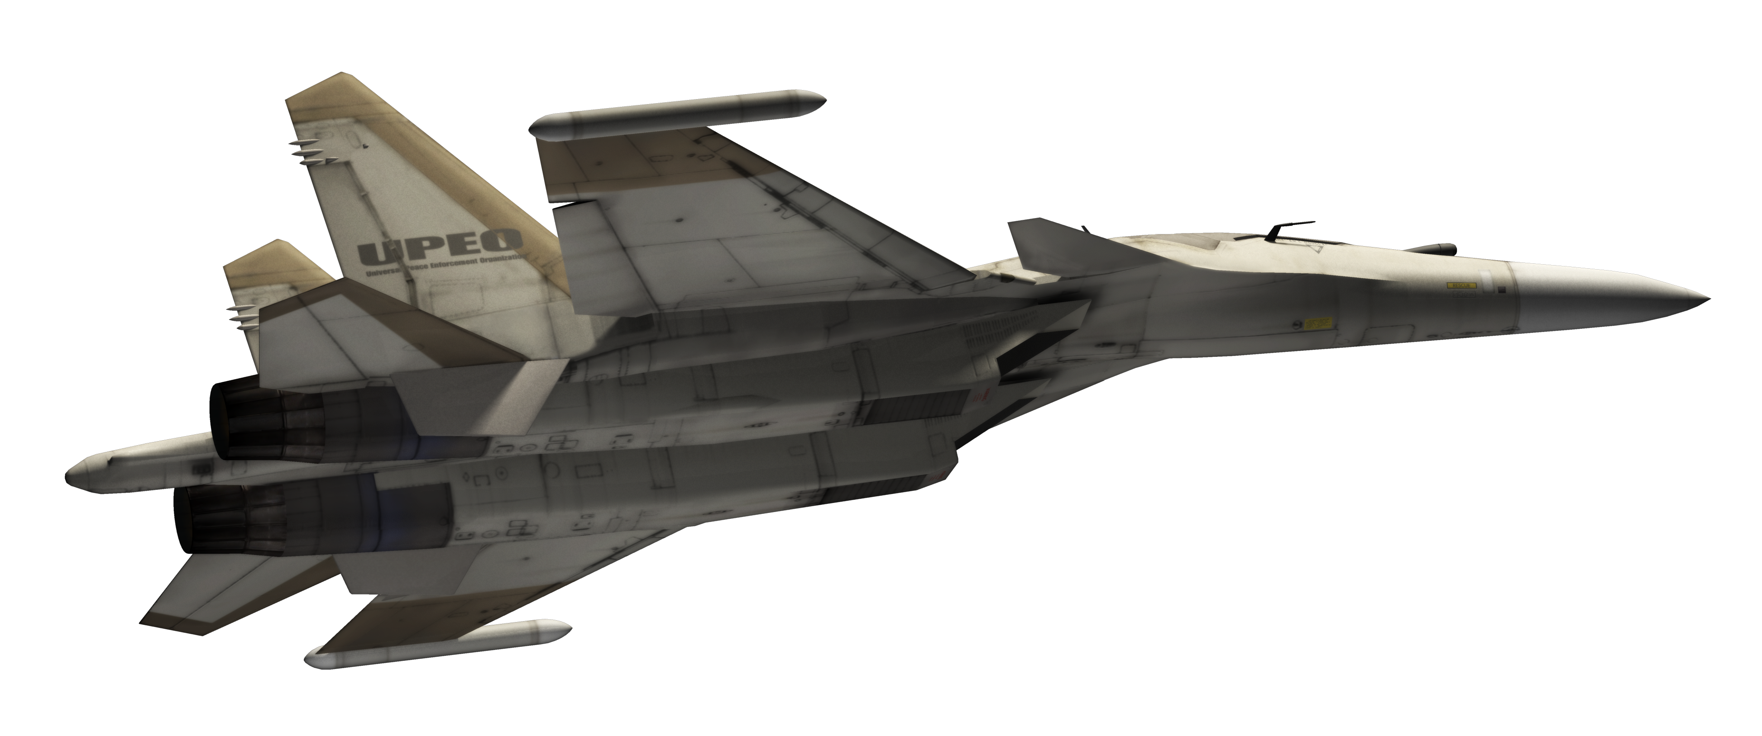
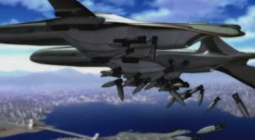
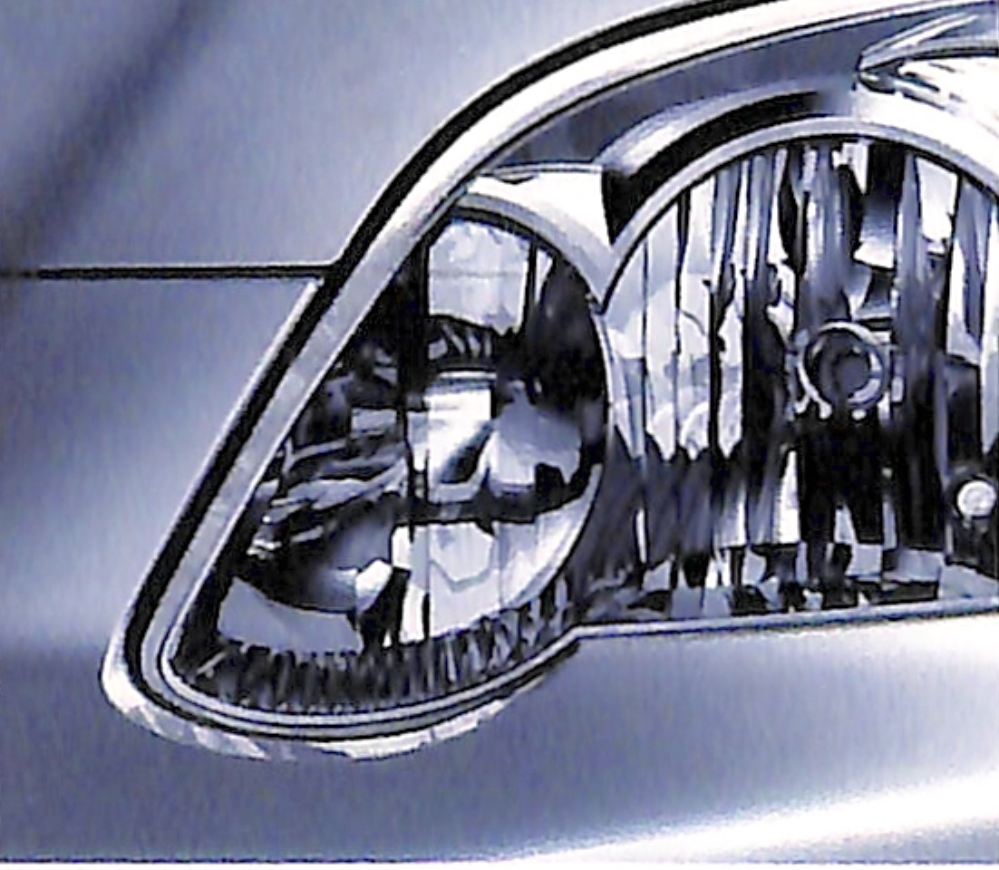
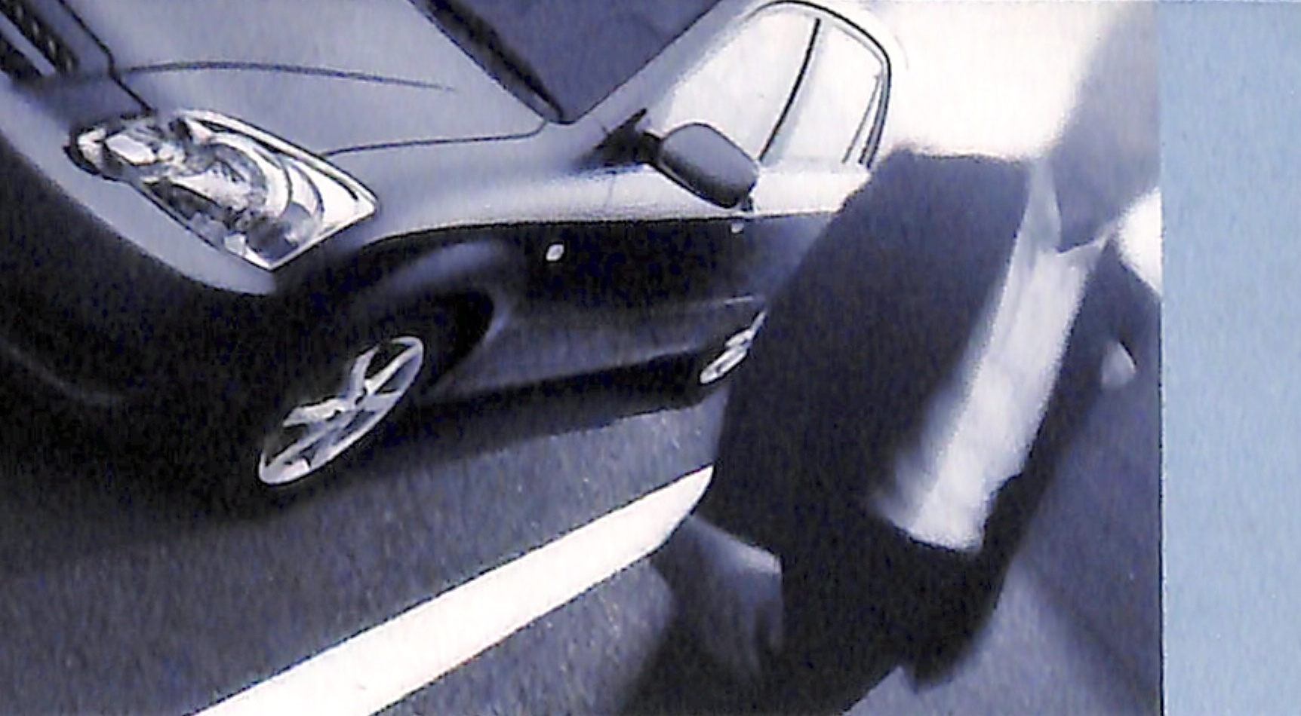
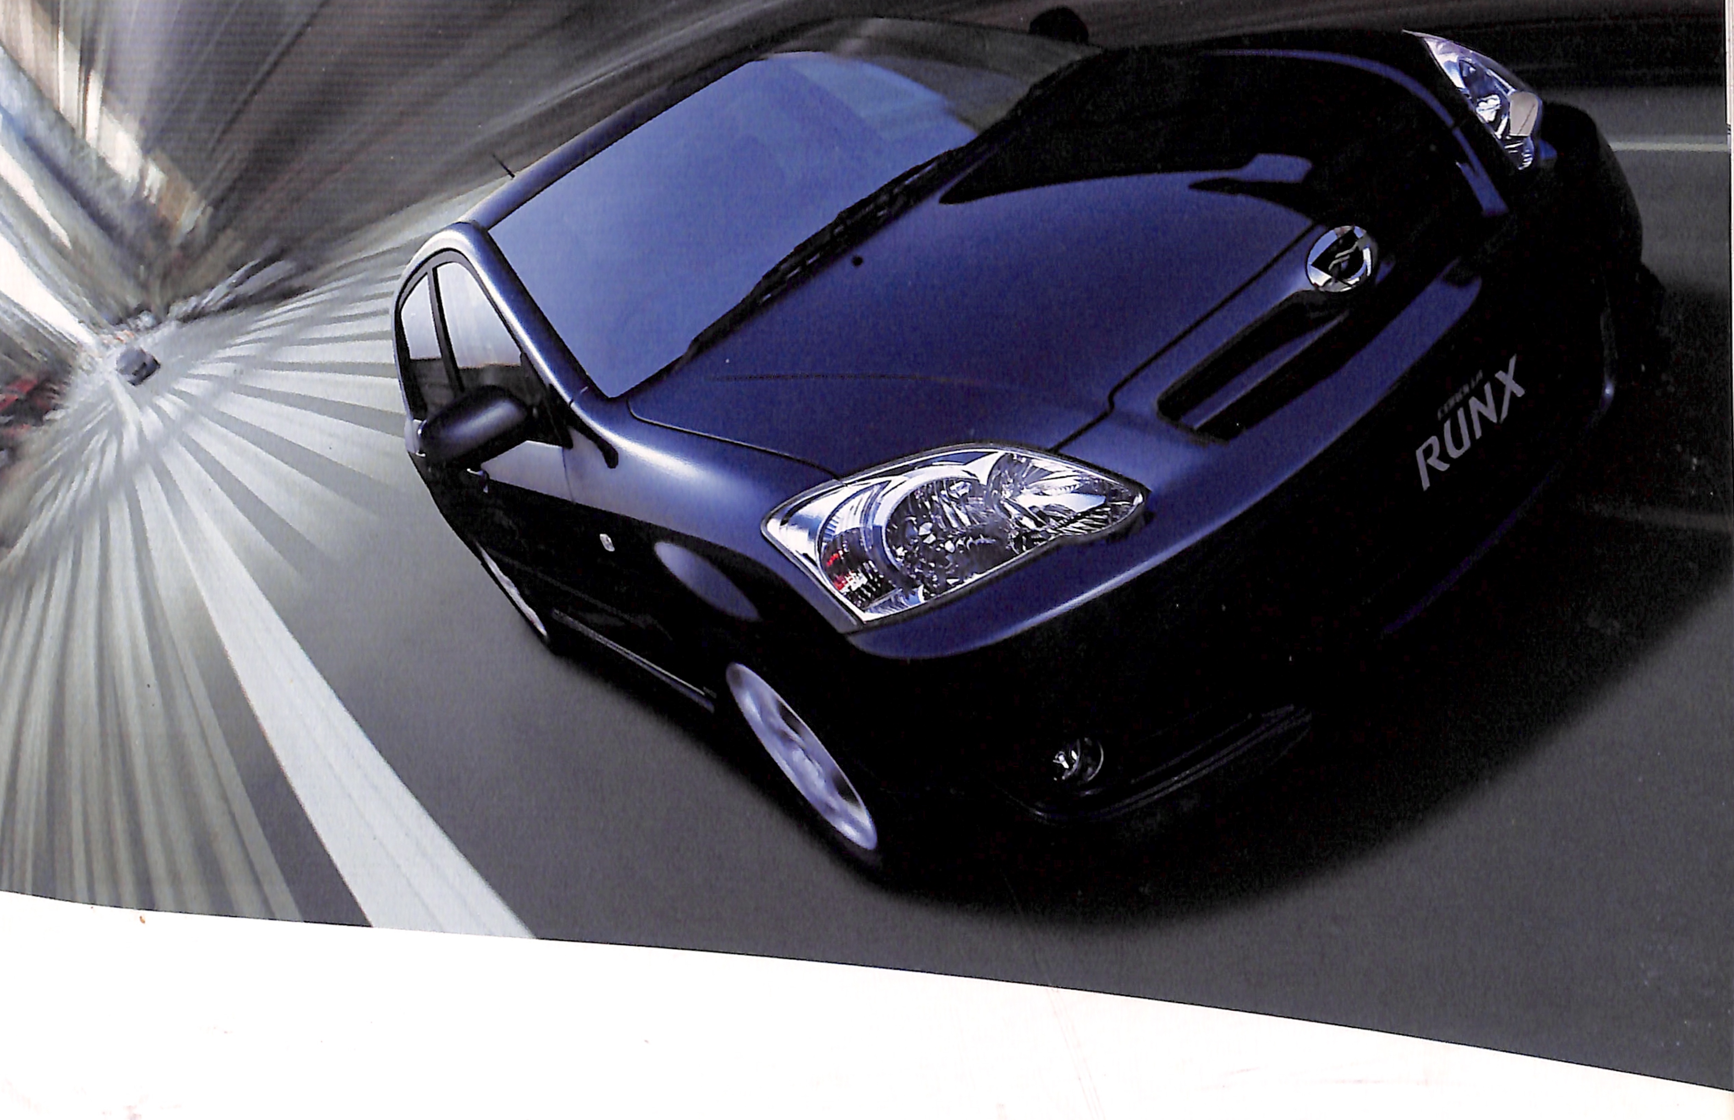
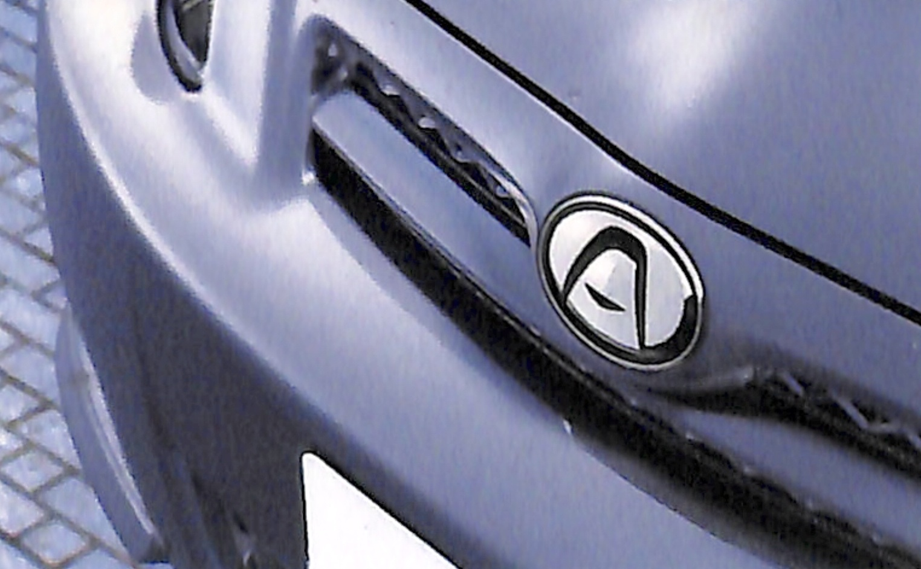
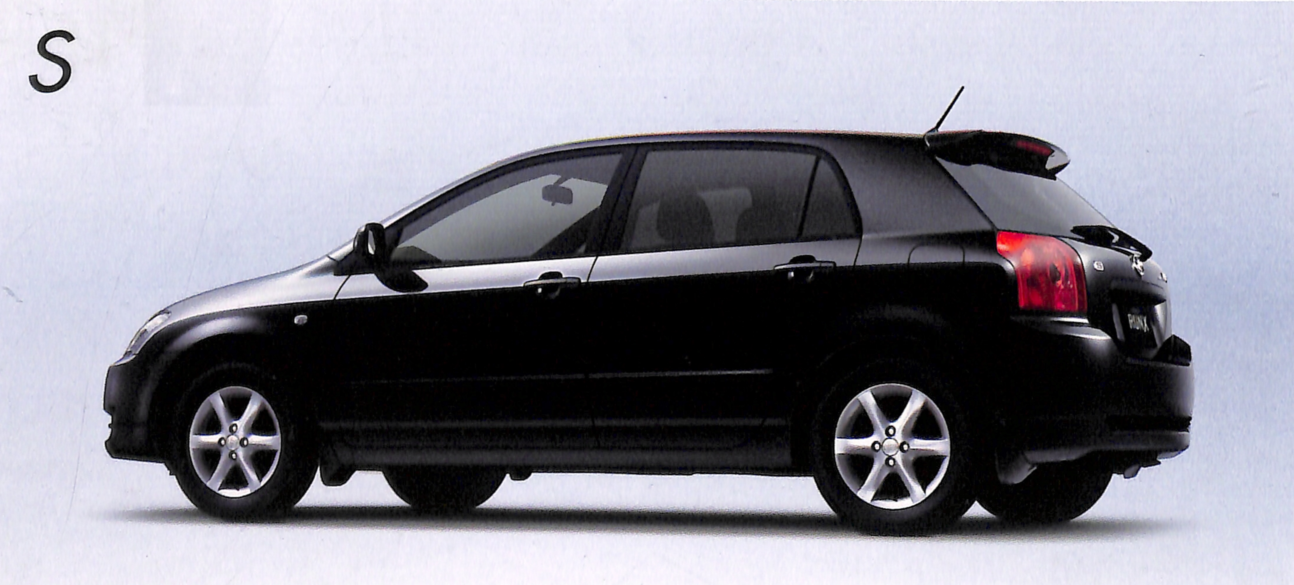
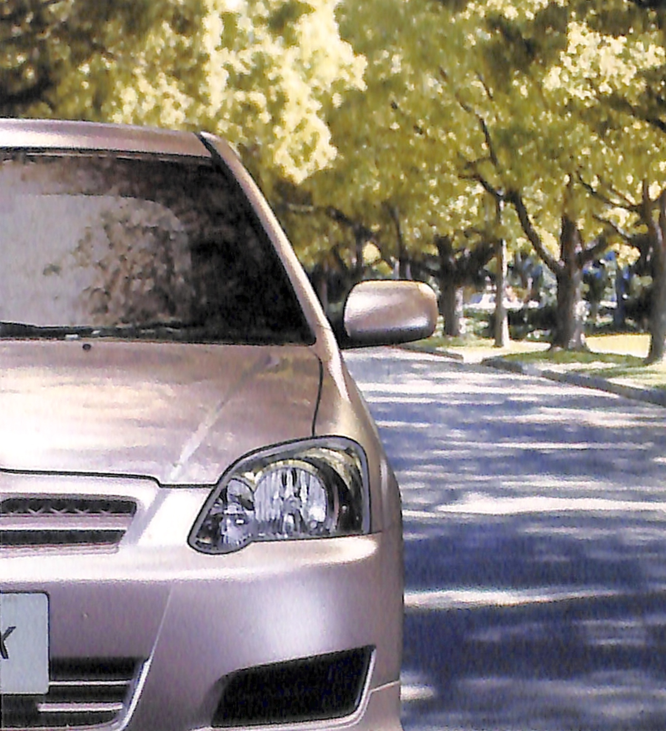
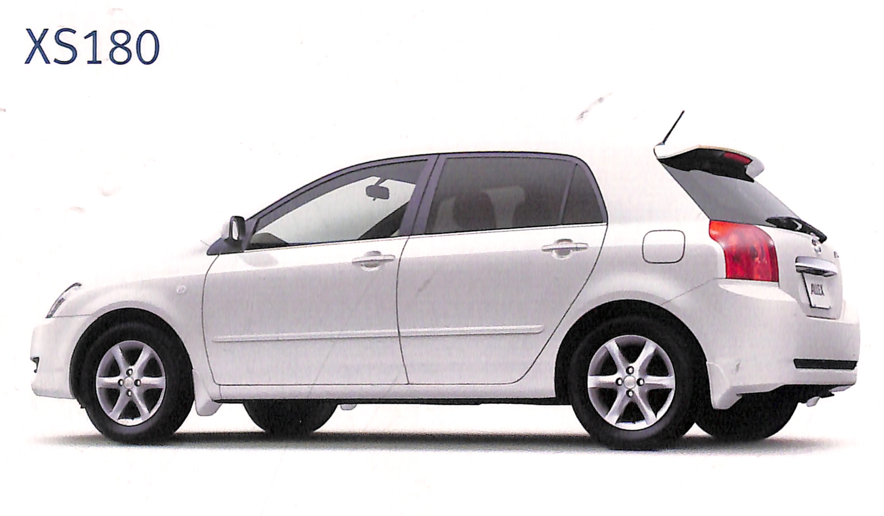
Video Game Projects
Industrial Product Projects

Slide 5
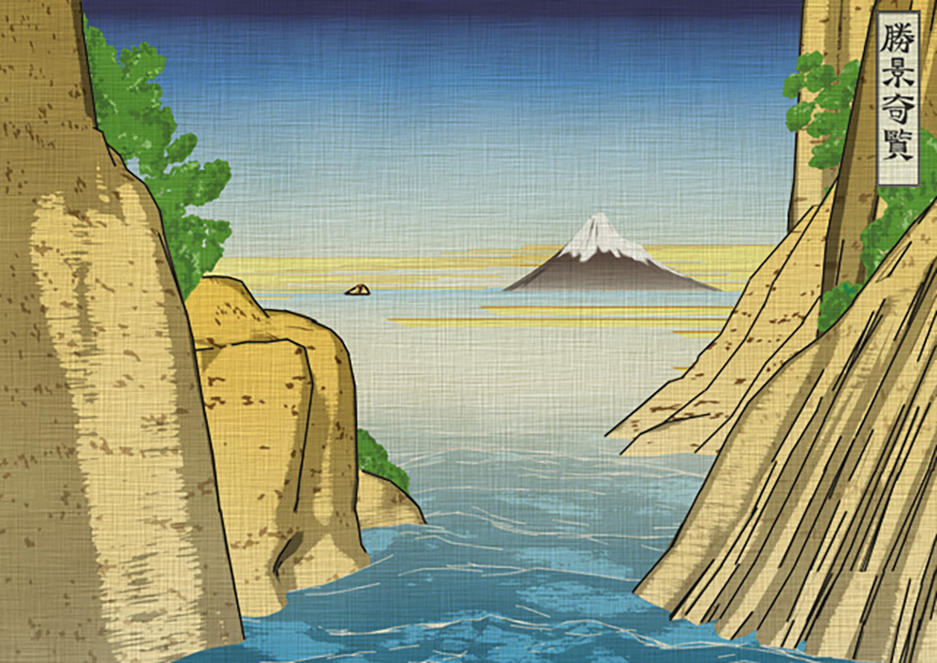
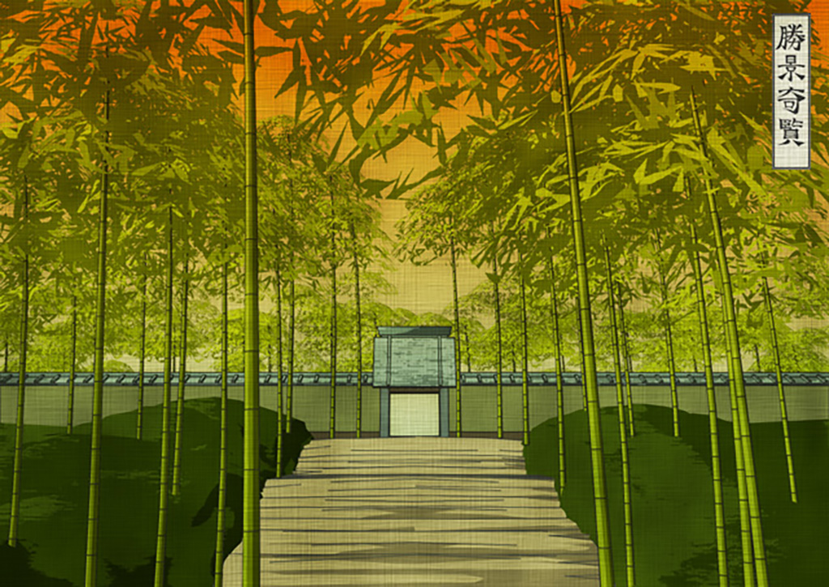
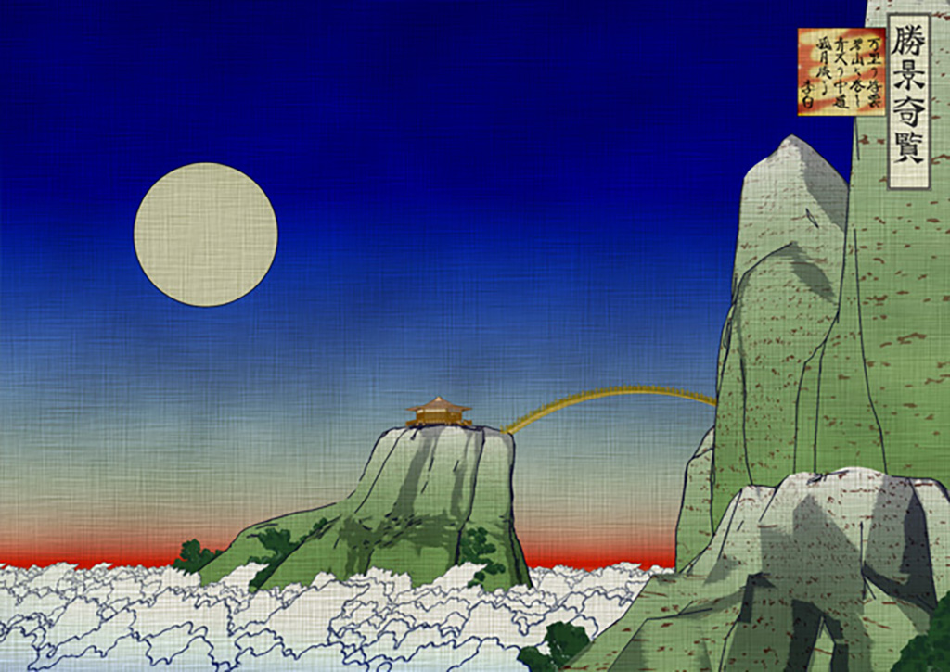
Examples of Illustrative-style Productions
“Splendid Views of Picturesque Landscapes”
https://youtu.be/01ctQNeoD54

Slide 6
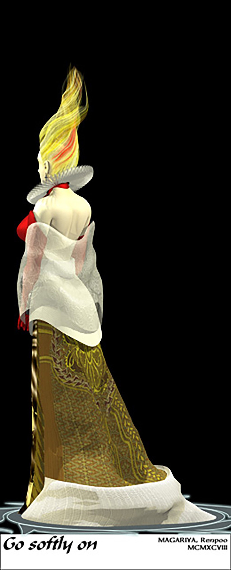
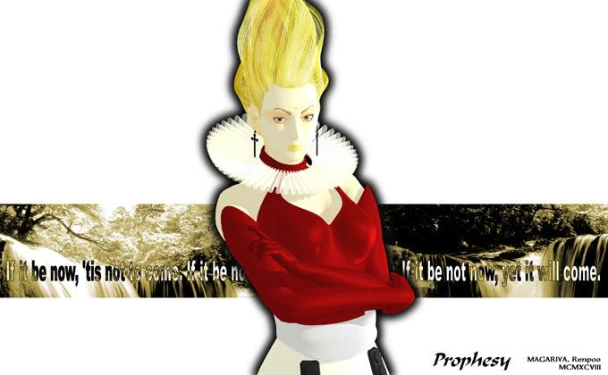
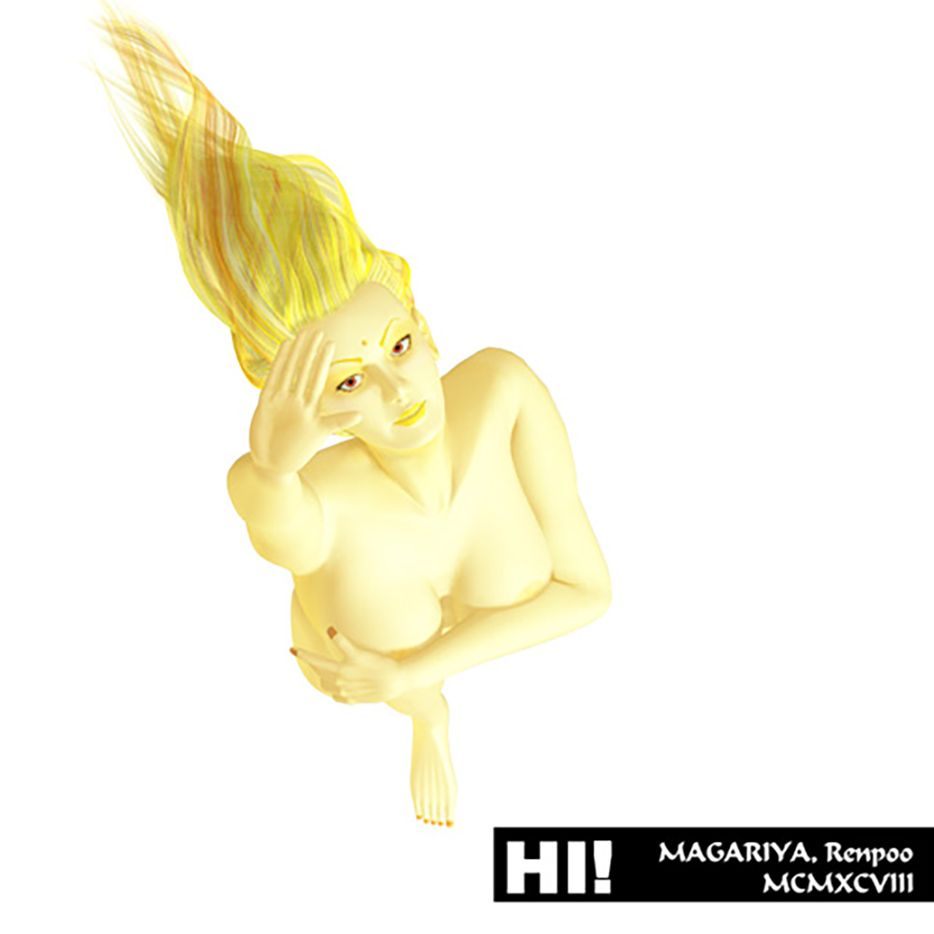
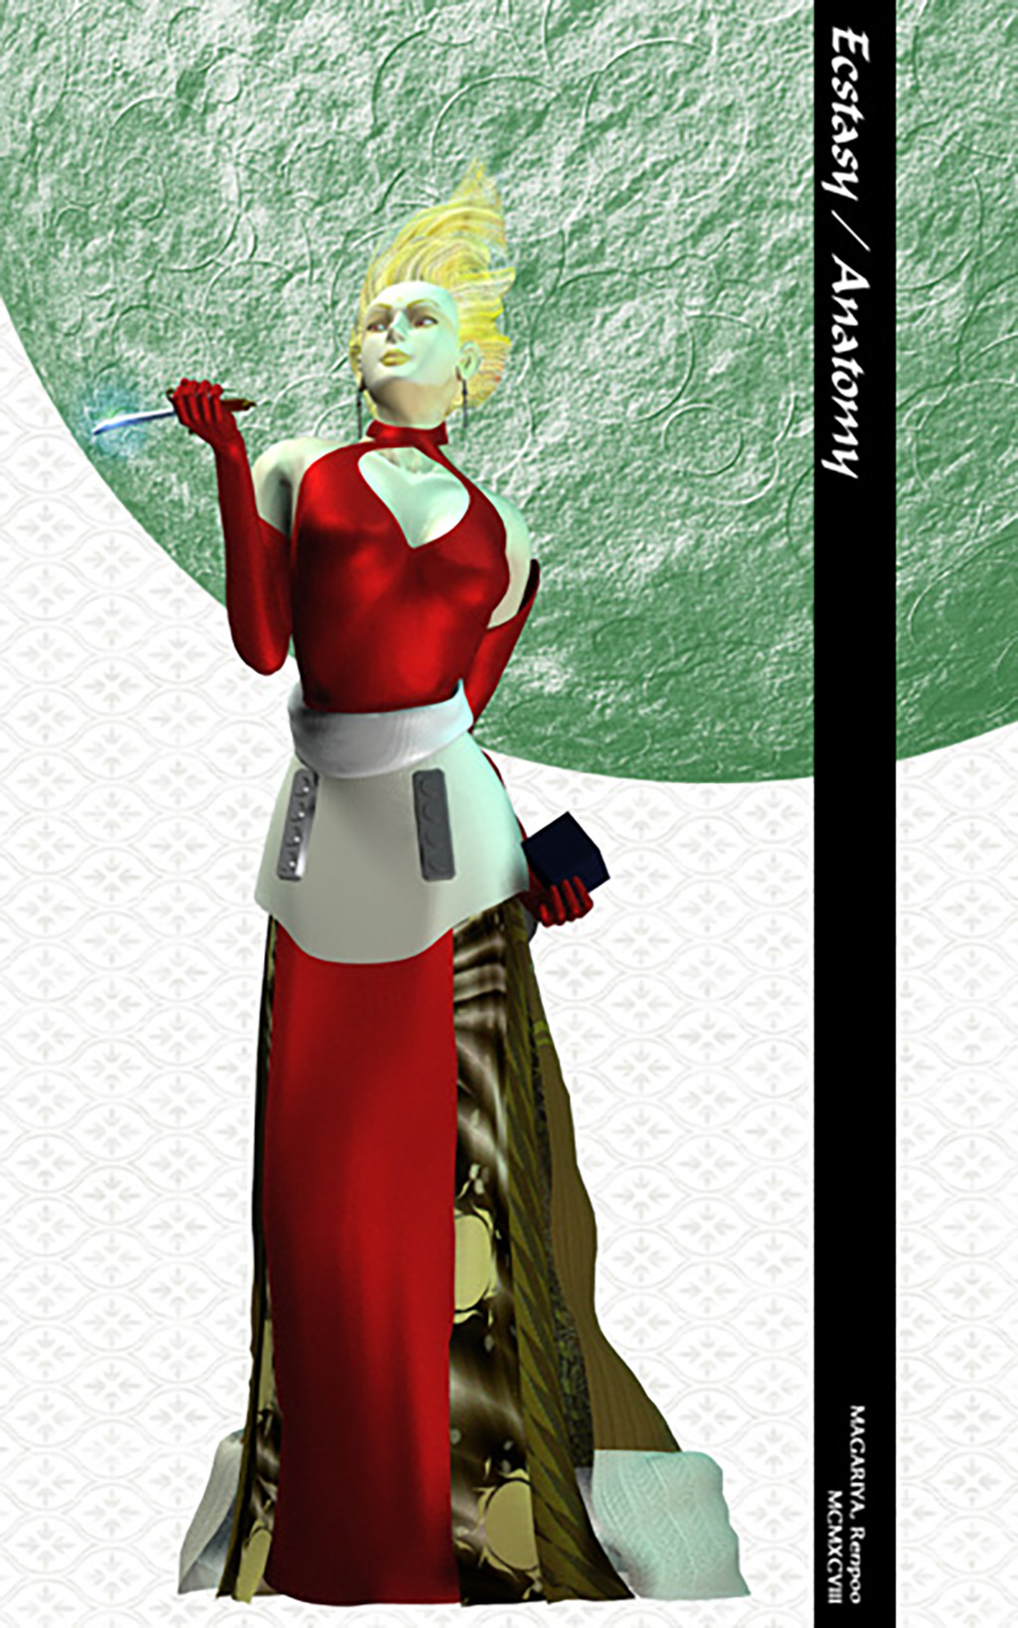
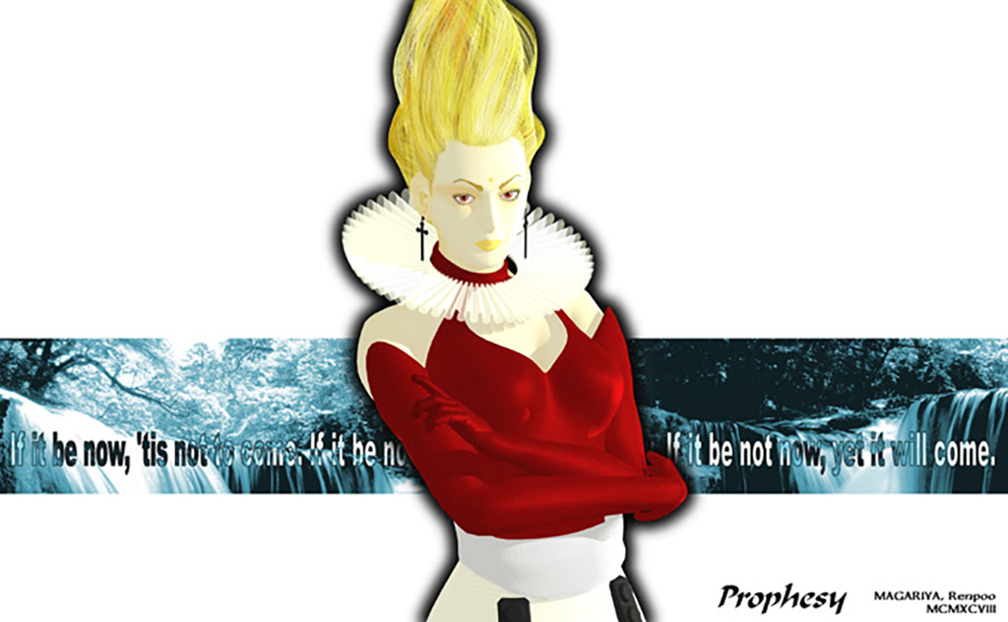
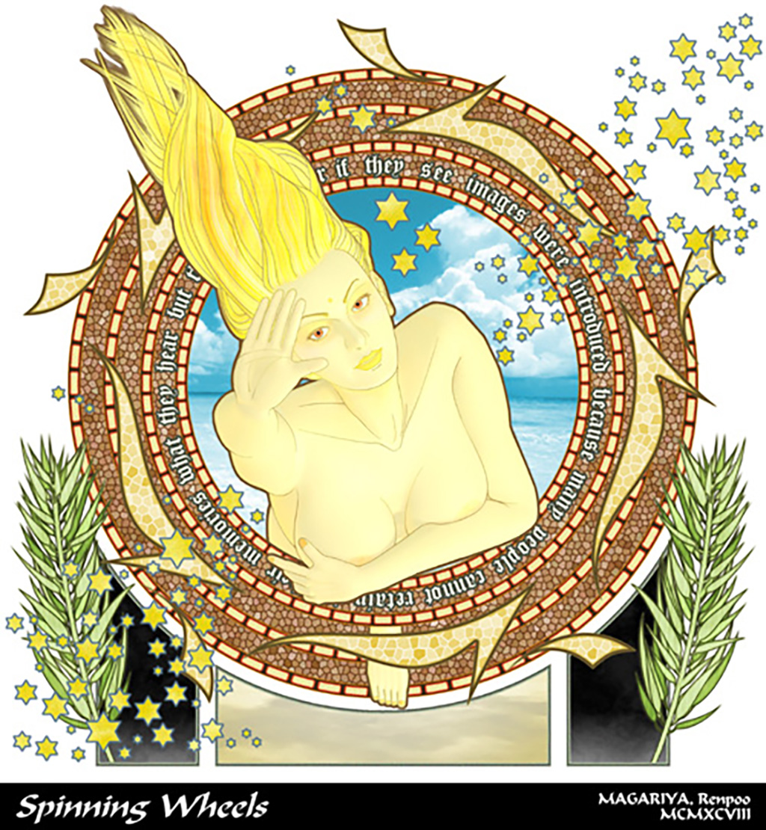
Exploring the Expression between "Illustrative" and "Realistic"

Slide 7
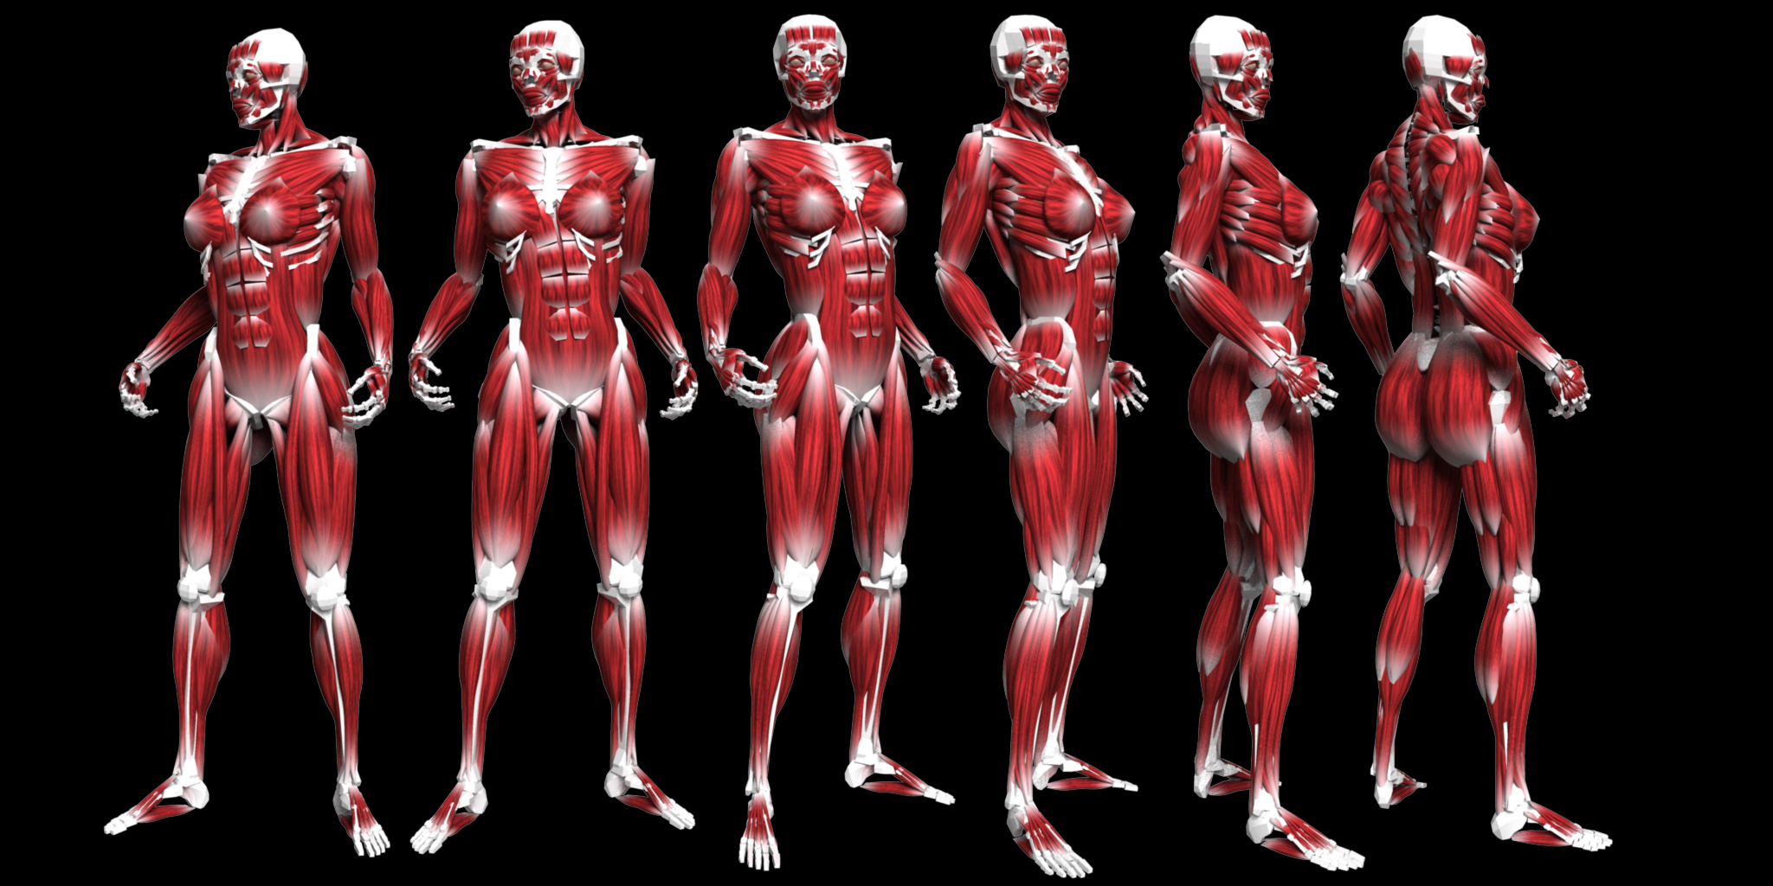
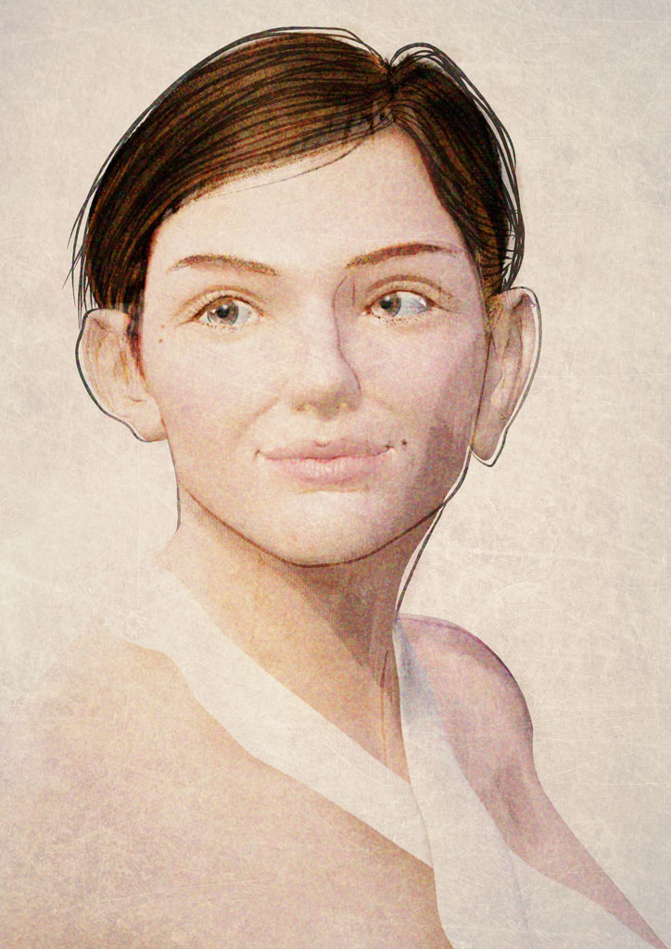
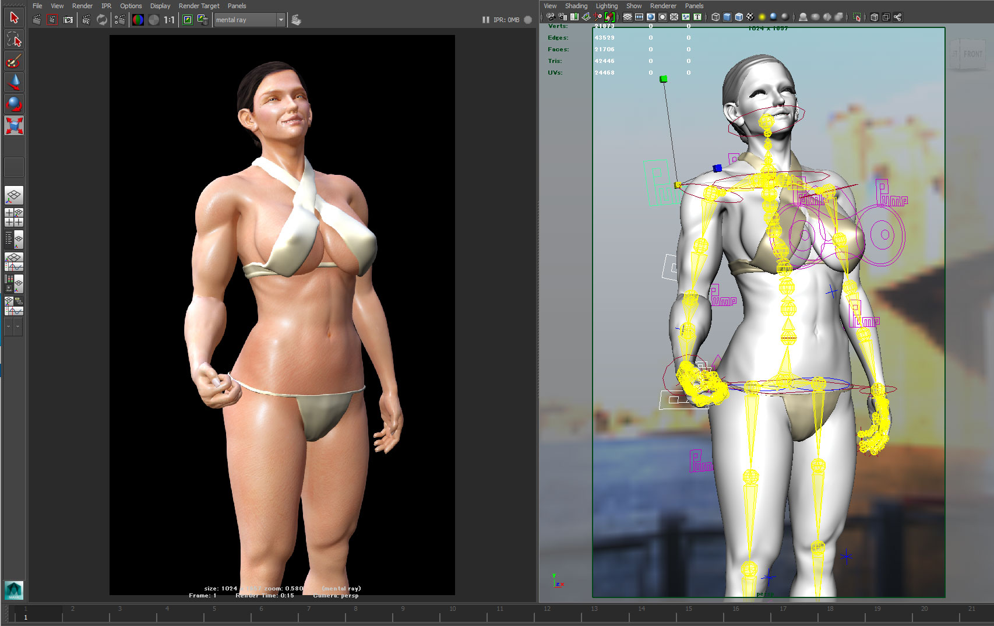
Building & Developing a Proprietary Human Model – “Miranda” –

Slide 8
Software Skills:
Maya
Power Animator
Lightwave3D
Adobe Creative Cloud

Slide 9
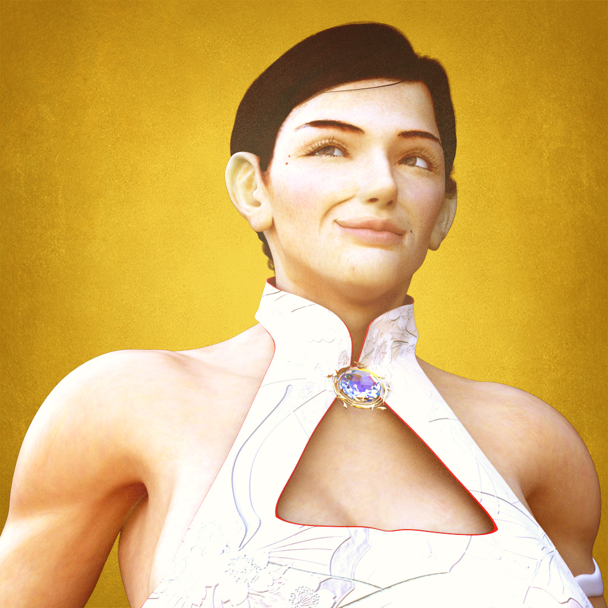
Personal Project: “Miranda”
A Virtual Human Body (Base Mesh Model) that Replicates Muscle Movement.
http://www.behind-universe.org

Slide 10
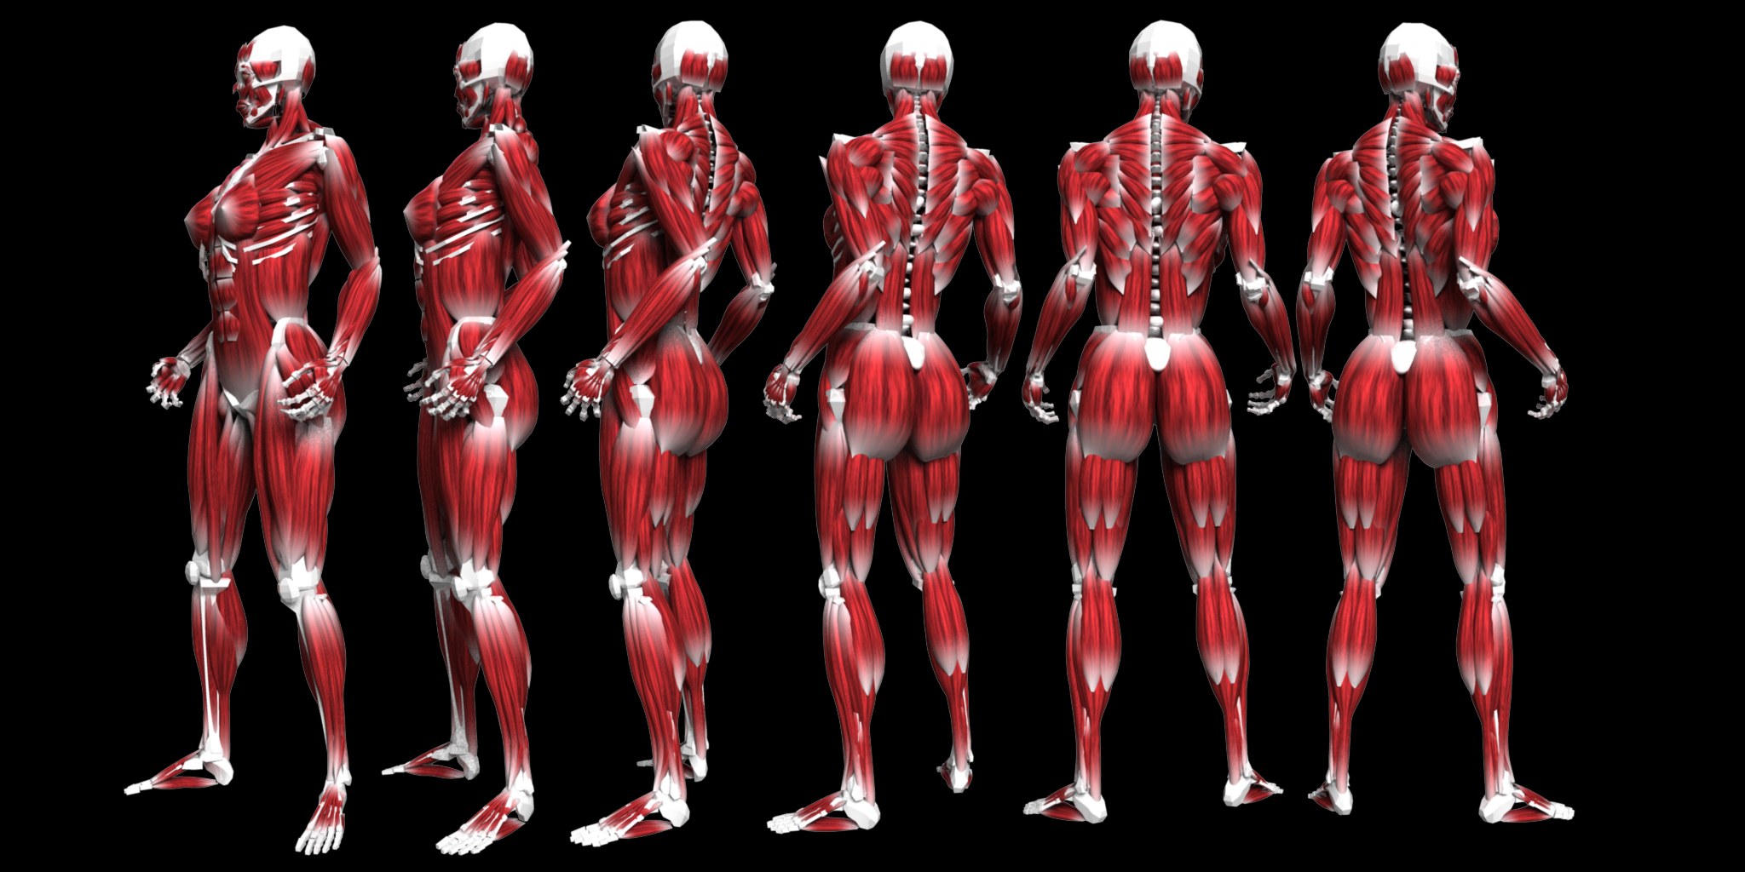
Originally, muscle movements were simulated using Maya Muscle (cMuscle).
Implemented with approximately 500 superficial muscles and bones.
Resulting in a Super Heavyweight Rig (File size exceeding 200 MB)

Slide 11
Optimized for Extreme Lightness
Converted to Blendshape Rig (Utilizing deformation and transformation functions).

Slide 12
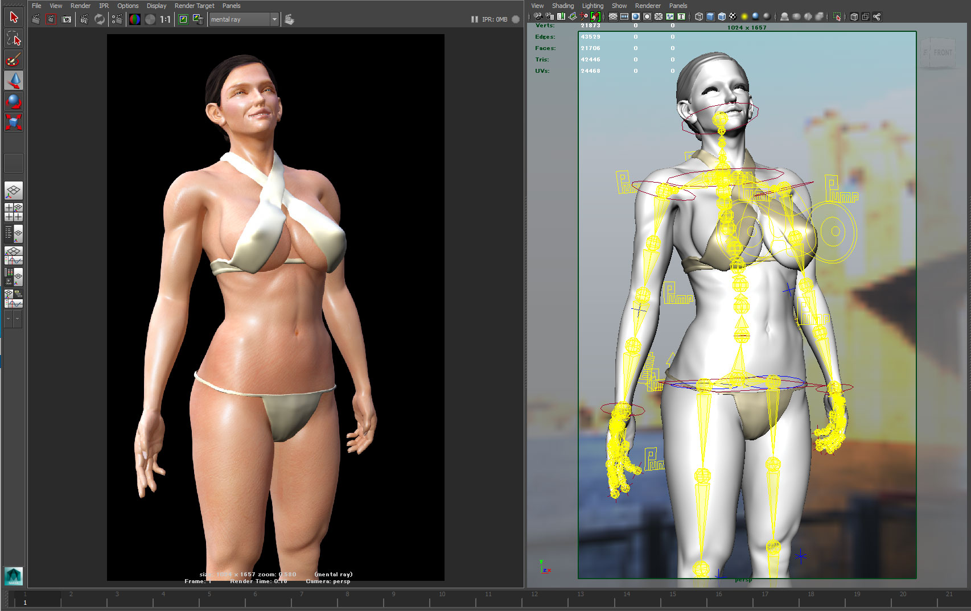
Converted to a high-quality Blendshape Rig (Using only skinCluster + Blendshape).
In other words, consolidated into a "skin and bones only" rig. When joints are bent, muscles respond by "tensing" and bulging, or "relaxing" and stretching.
Into a Lightweight Rig (File size of approximately 100 MB)

Slide 13
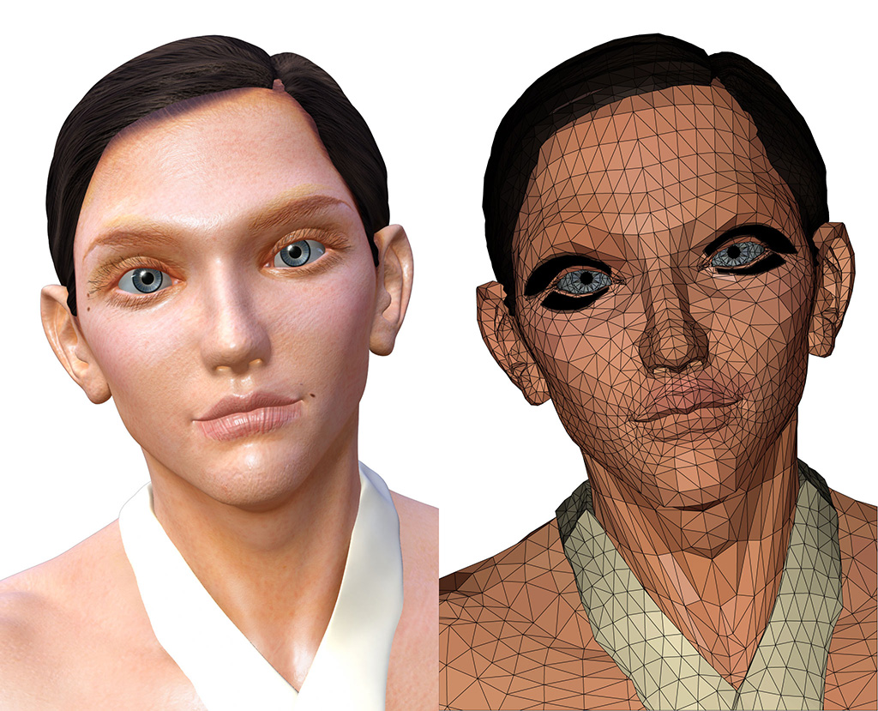
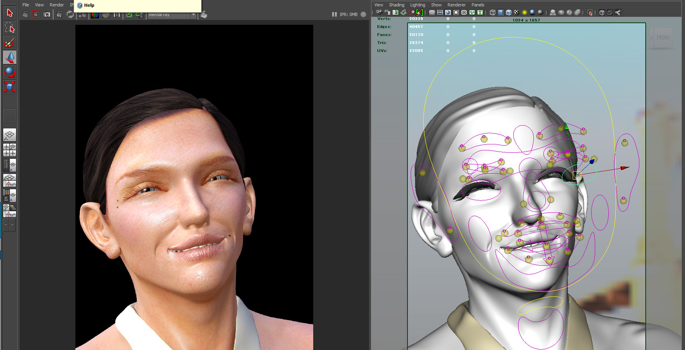
The Facial Rig was also converted to skinCluster only, meaning it is driven by just "skin and bones."
Facial expressions can be freely created with controllers.
Animation of displacement maps
is not yet supported, but can be implemented.
This means it can be adapted to handle detailed surface expressions like wrinkling.

Slide 14
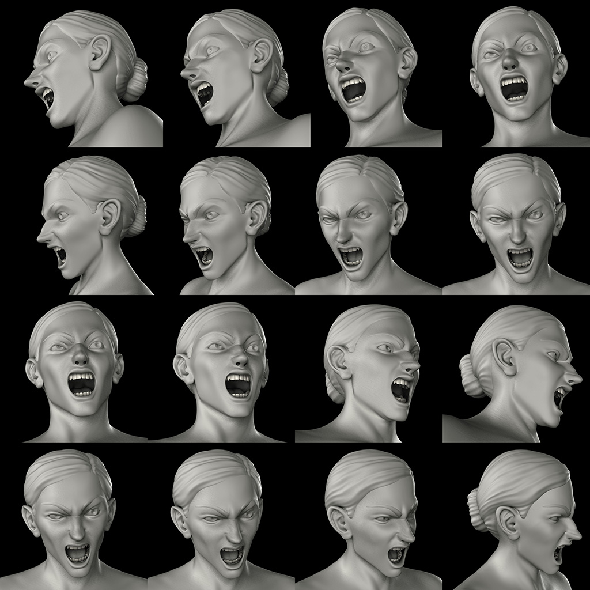
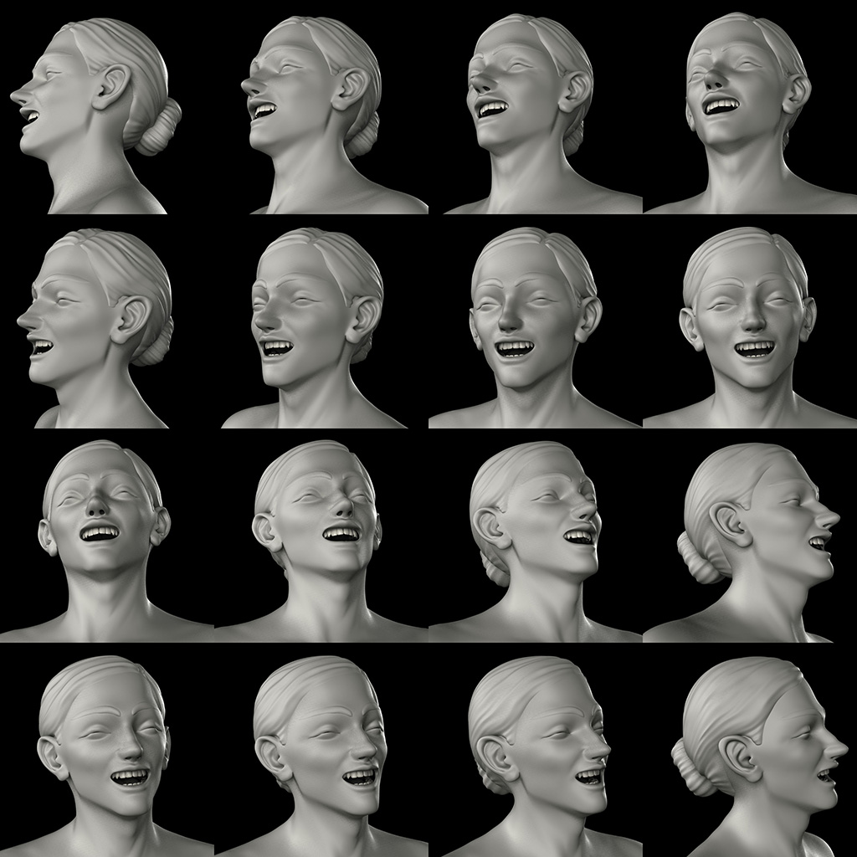
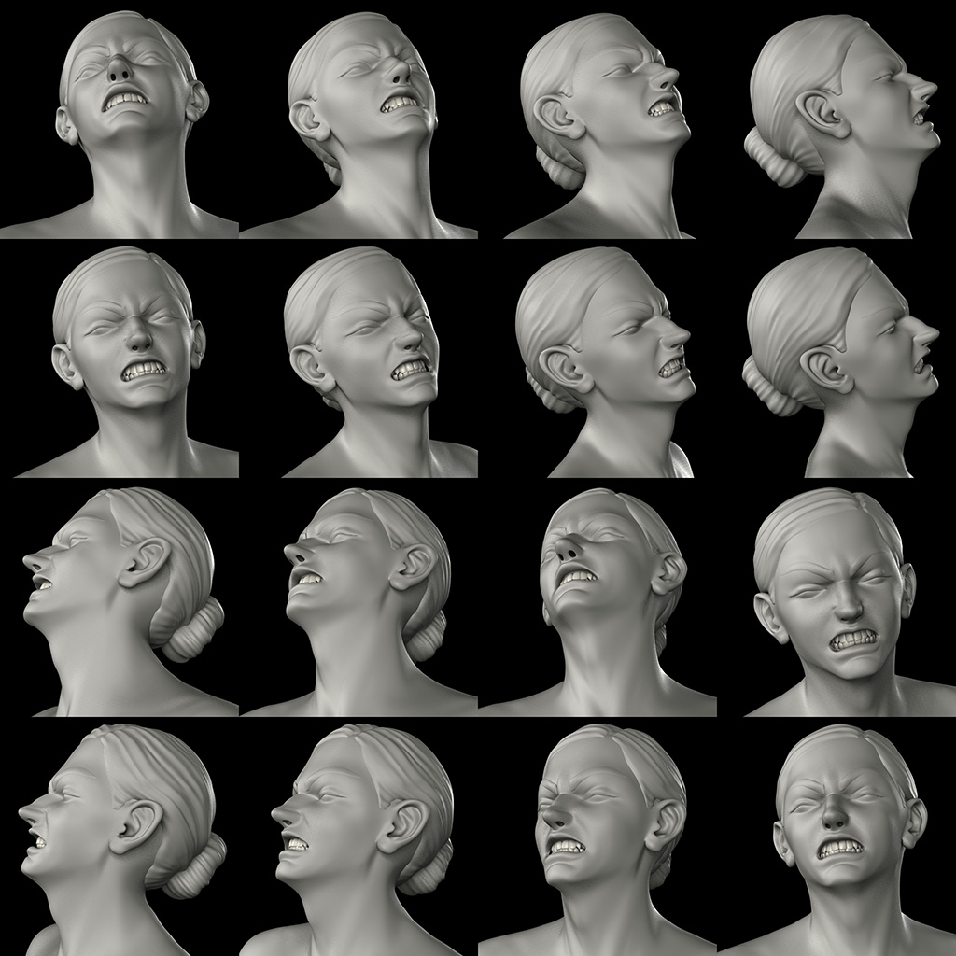
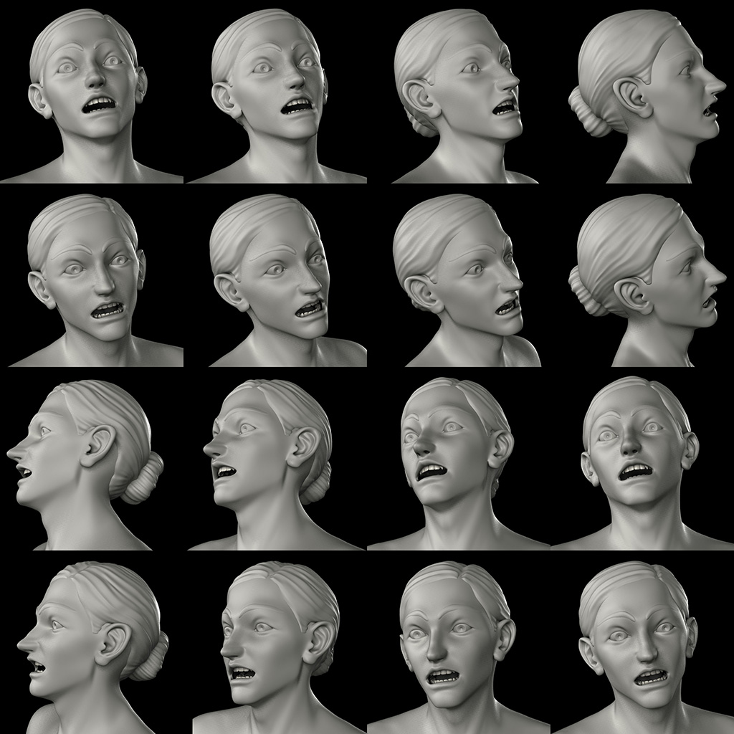
A Wide Range of Rich Facial Expressions is also Possible.

Slide 15
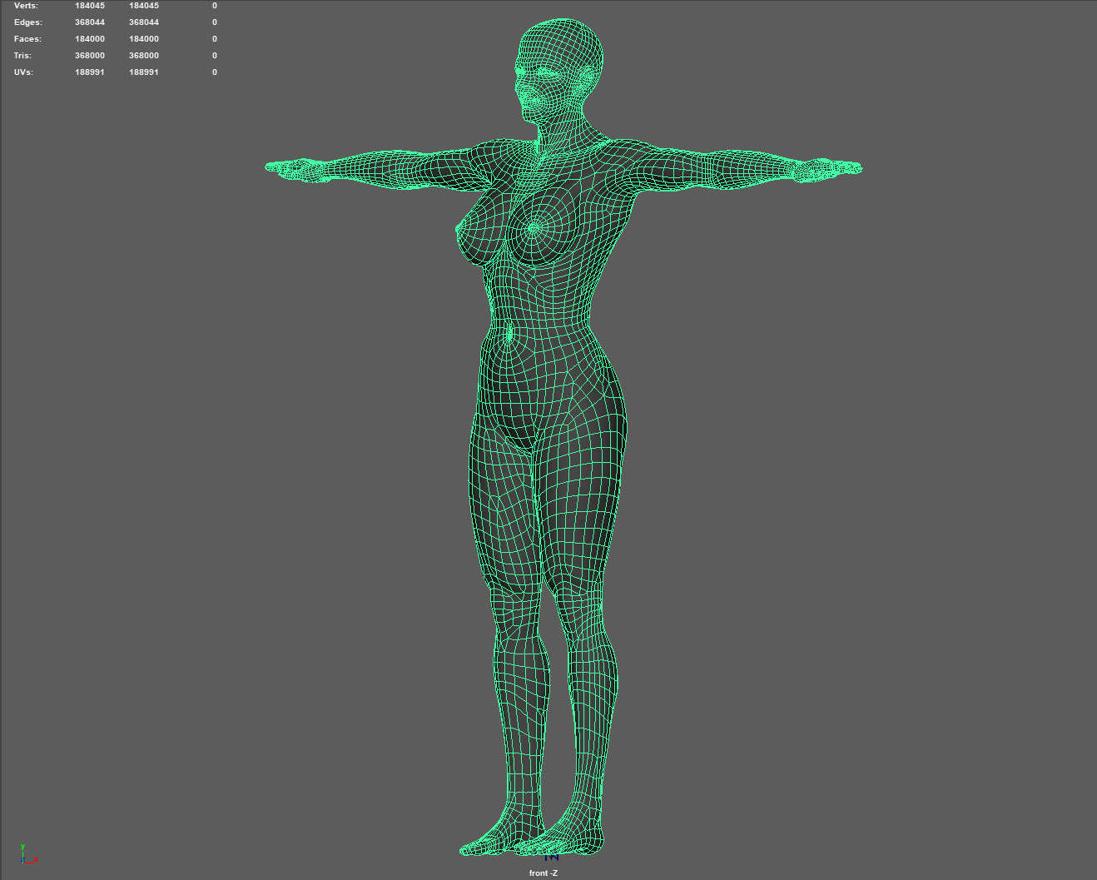
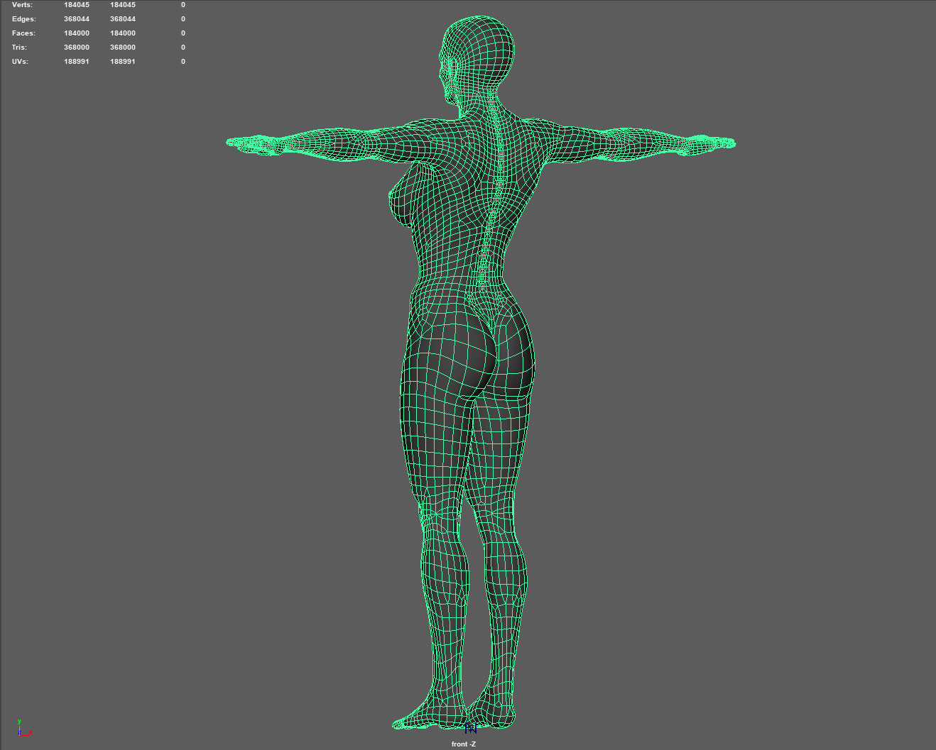
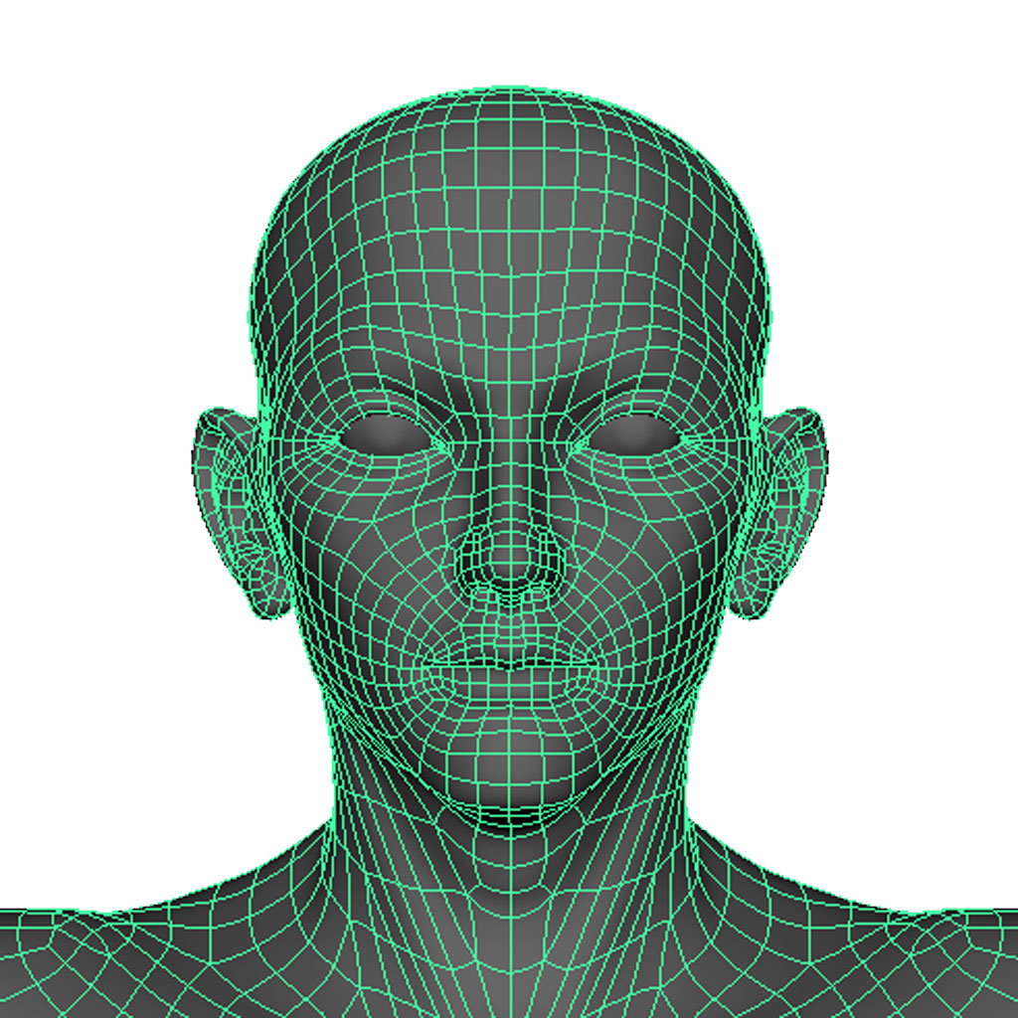
Polygon Mesh Topology
Designed to Follow the Muscle Flow.
Expressions showing the movement of the spine are also possible.

Slide 16
Processing Architecture
Skin
↑ Visible ↓ Invisible
Male, Female, Anime, etc.
Body
Other Body Shapes
Left Arm, Right Arm, Left Leg, Right Foot, etc.
Muscles
Skeleton
Body Control
Facial Control

Slide 17
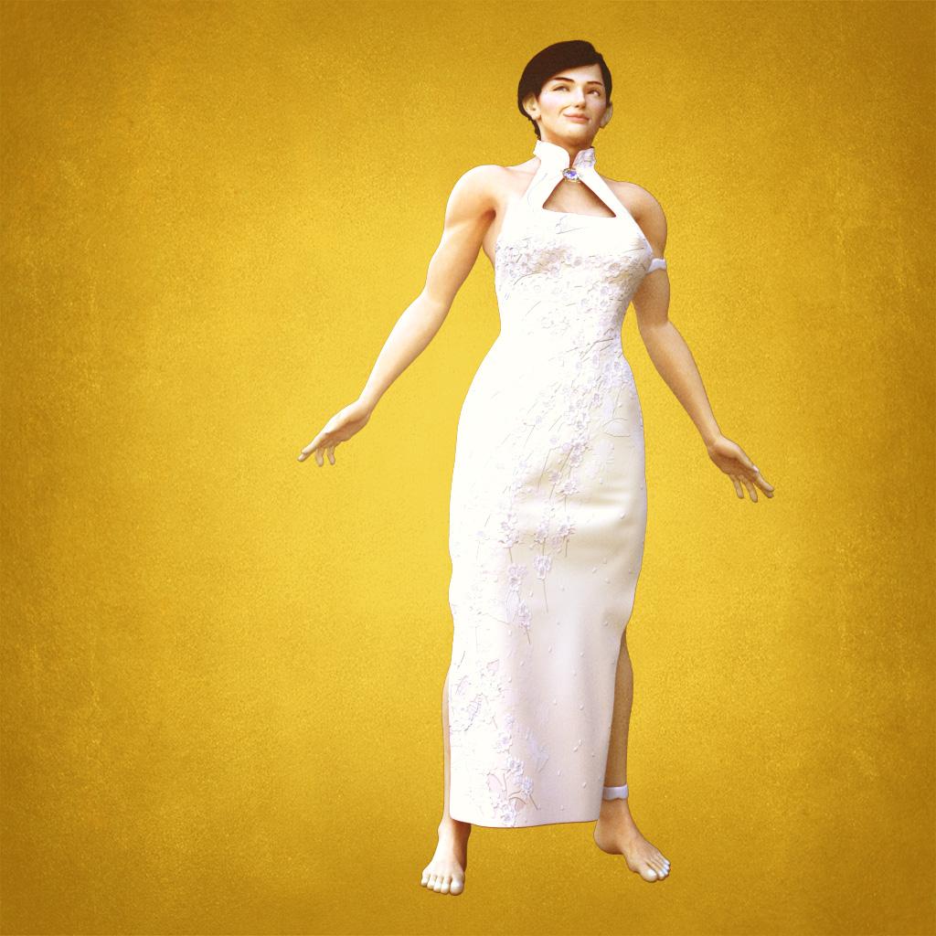
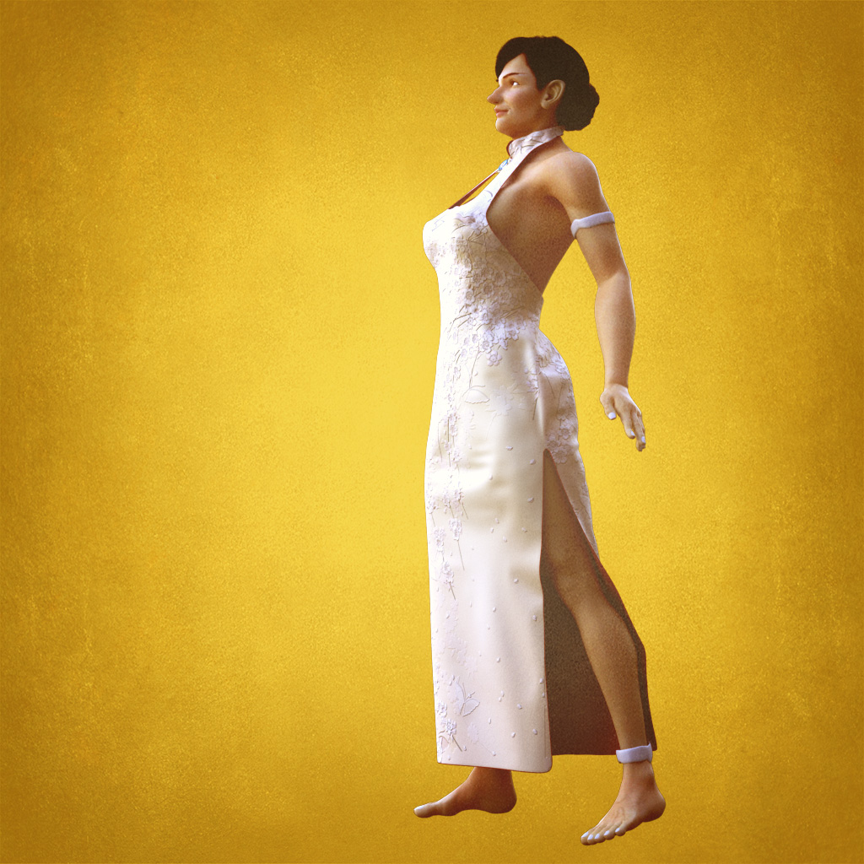
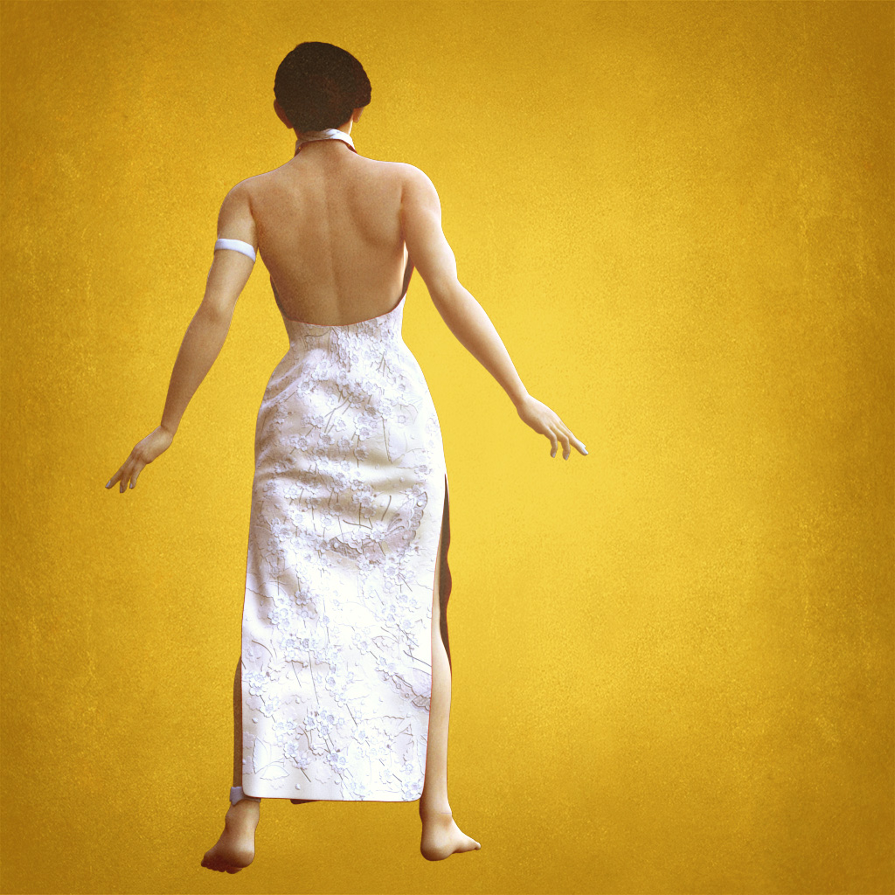
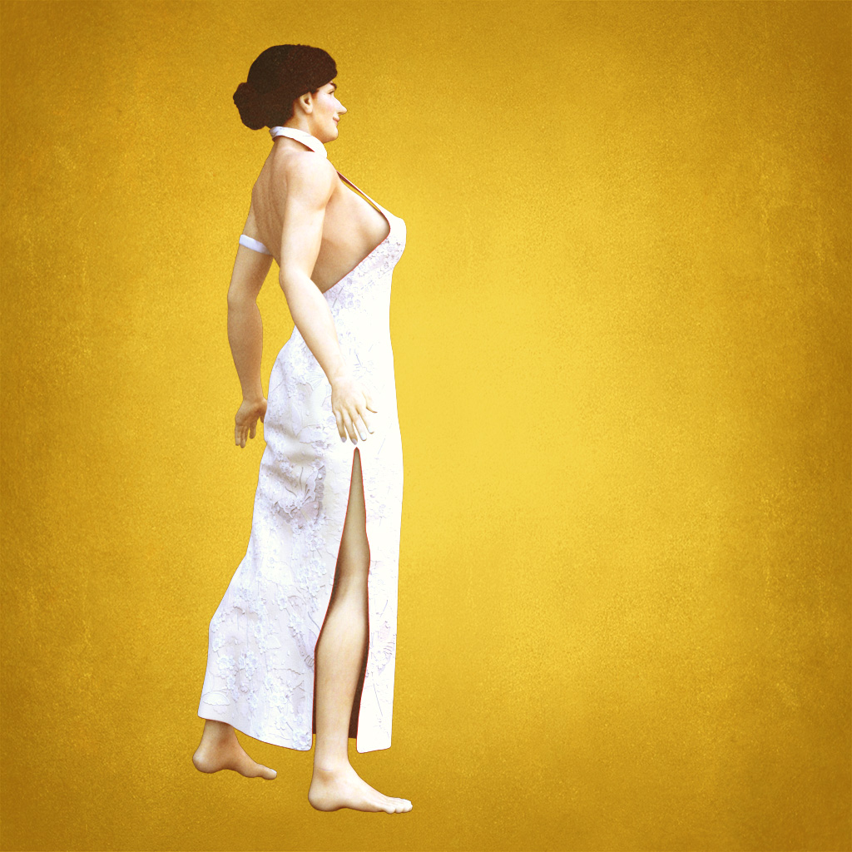

Slide 18
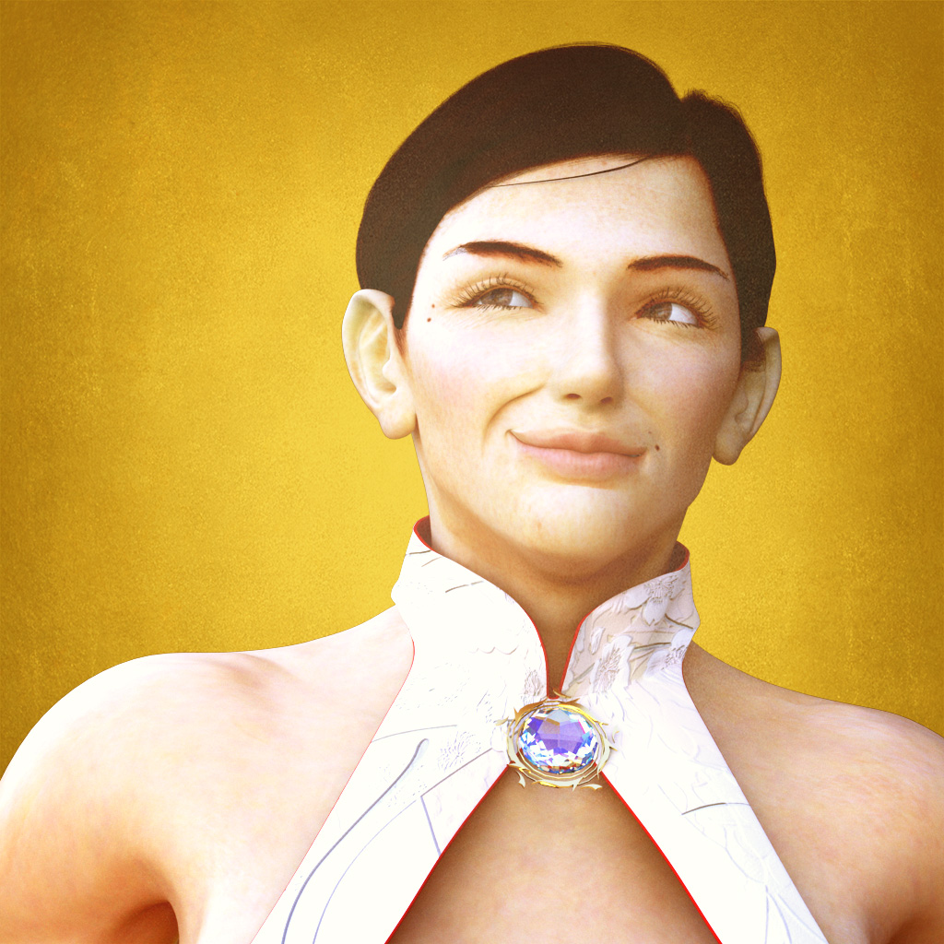

Slide 19
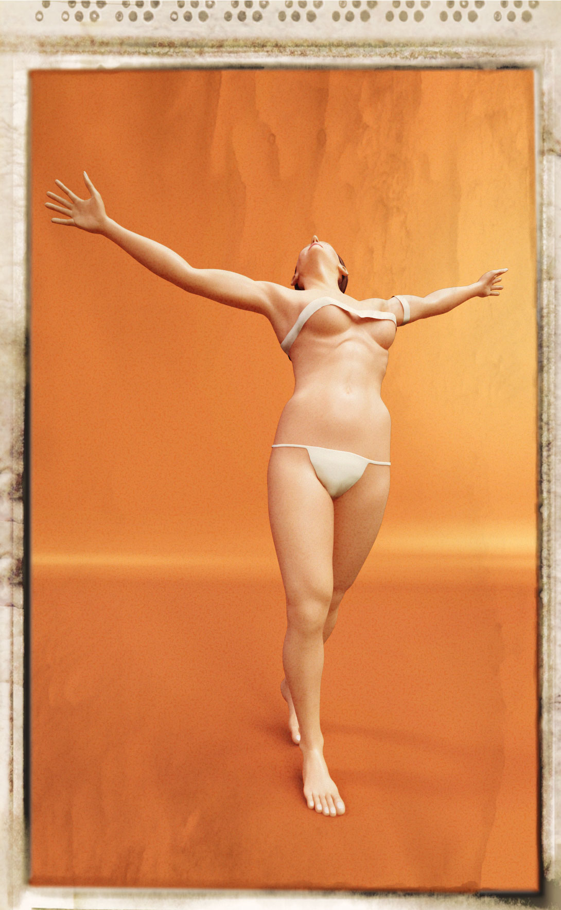

Slide 20
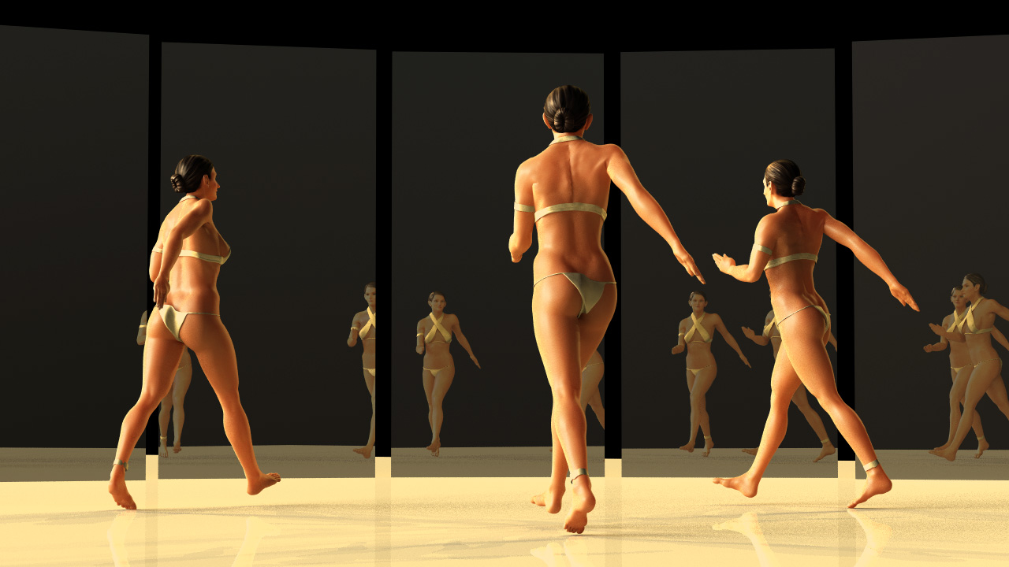
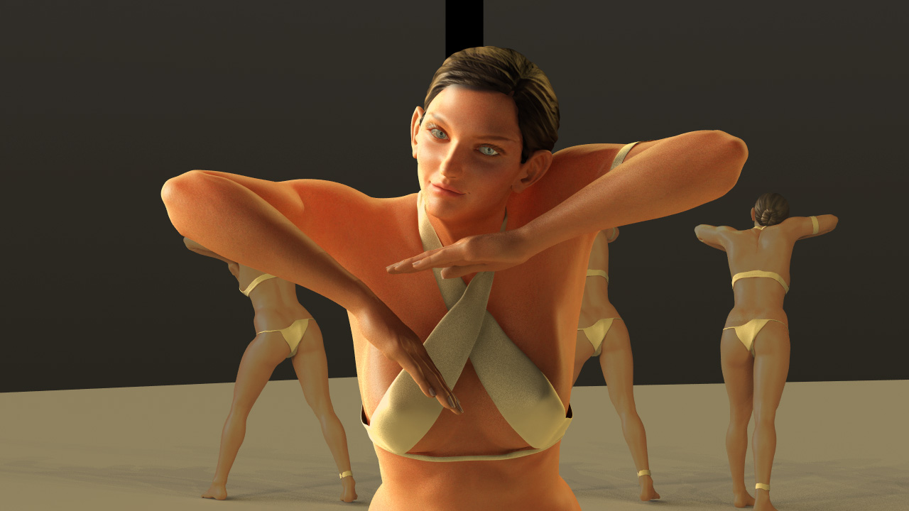
Homepage: (Data distributed under a Creative Commons license)
http://www.behind-universe.org
Demo Reel:
https://youtu.be/2w8Ro1pYD9Y
Sample Footage:
https://youtu.be/f9zmkpxDepg

